Slide 1

    S H O V O N K N I T W E A R L I M I T E D
    S I N C E - 2012

Slide 2
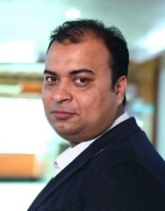
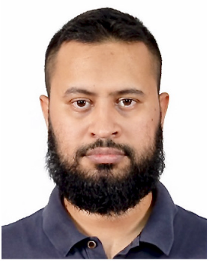
Key Persons
Iqbal Yousuf Shovon
Managing Director
Taufiqul Islam Antu
Director

Slide 3
    S H O V O N K N I T W E A R L I M I T E D
Our Concern
Knitwear Division
-Fabric Knitting Unit
-Fabric Dyeing Unit
-Yarn Dyeing Unit
-Automatic Machine Printing Unit
-All Over Fabric Printing Unit
-Knit Garments Production Unit
Accessories Division
-Printed Labels Unit
-Packaging Unit
-Embroidery & Sewing Thread Unit

Slide 4
Why Choose Our Products ?
•
Quality Assurance
•
Resilient Performance
•
On Time Delivery
•
Competitive Prices
•
Better Communication

Slide 5










Our Customers

Slide 6




Factory Profile
Unit : Fabric Knitting
Product Category : Single Jersey, Rib, Interlock
Pique, Jersey with Lycra , Fleece.
Machineries : Fukahama - Taiwan
Lisky - Taiwan
Jiunn long – Taiwan
Around Star - Taiwan
Matsuya - Japan

Slide 7
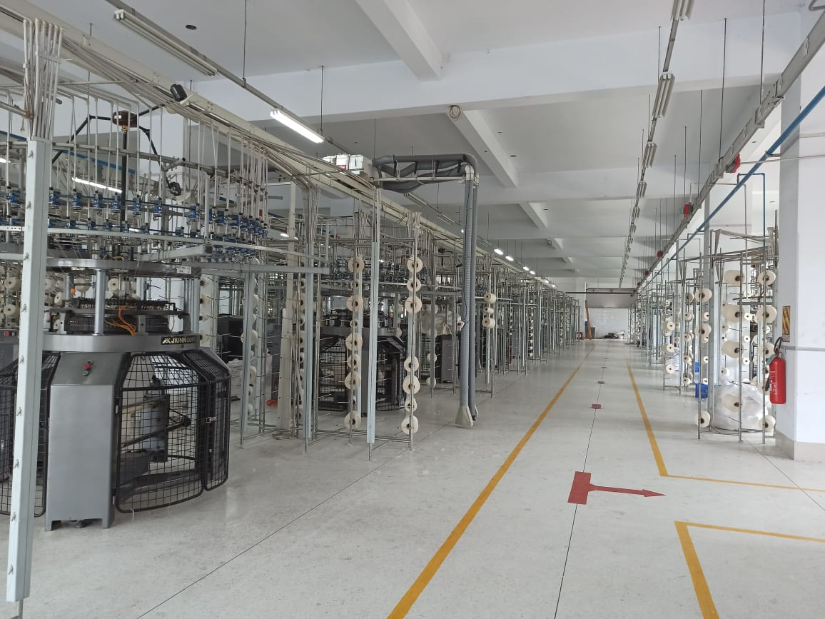
Fabric Knitting Machines
Fabric Knitting Unit

Slide 8



Factory Profile
Unit : Fabric Dyeing
Dyeing Category : Cotton , P/C , CVC, T/C.
Machineries : Dyeing Machines : Fongs – China
Sclavos – Greece
Dewatering : Fab-con - USA
Calator - Sweden
Bianco - Italy
Dryer : Tung Yang – Taiwan
Fongs – China
Stenter : Bruckner – Germany
Ehwha – Korea
Compactor : Lafer – Italy
Fab-con – USA
Tube-tex – USA
Soft Setting Calendar : Dong Nam
Sueding Machine: Lafer - Italy

Slide 9
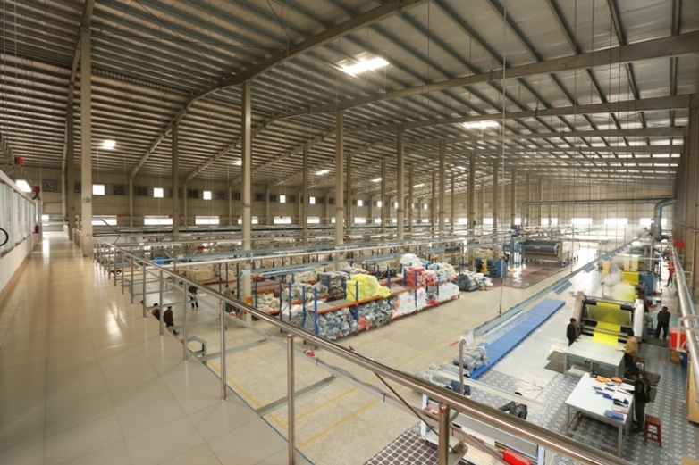
View from top
Fabric Dyeing Unit

Slide 10
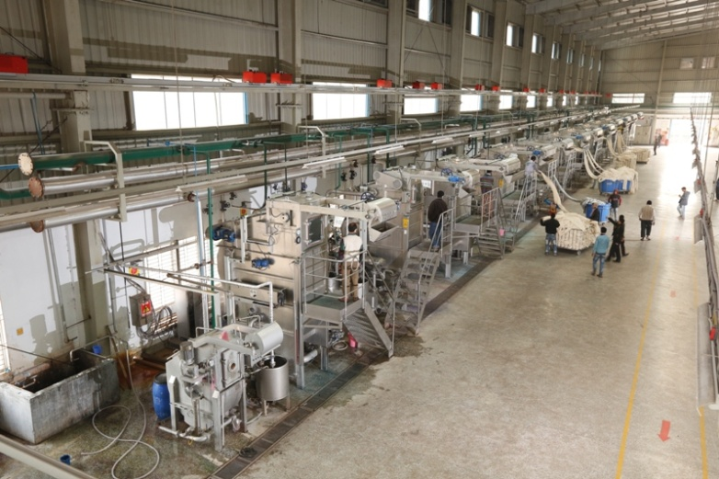
Dyeing Machines
Fabric Dyeing Unit

Slide 11
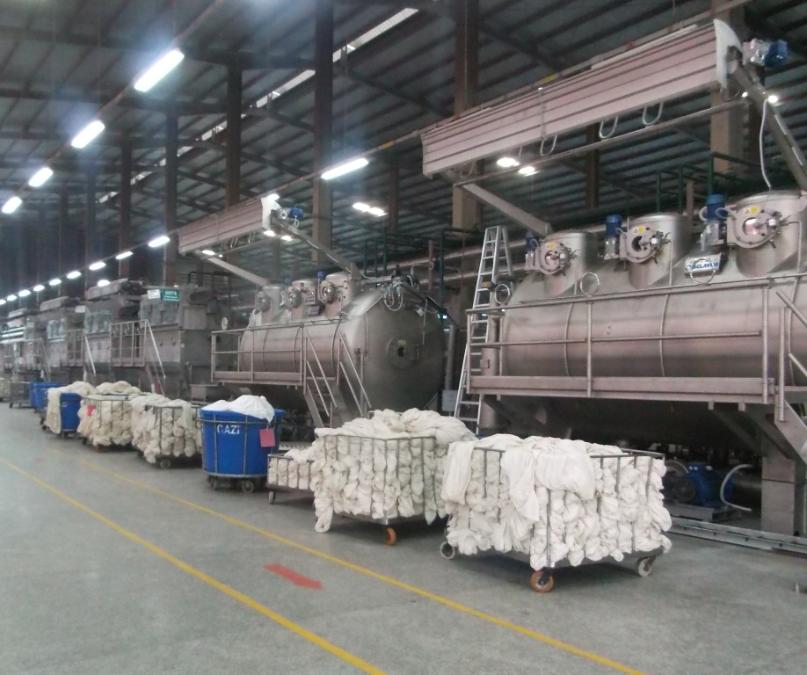
Dyeing Machines
Fabric Dyeing Unit

Slide 12

Factory Profile
Unit : Yarn Dyeing
Product Category : Acrylic, Cotton, 50/50 Cot/Acr, 70/30 Acr/Wool, Acr Mohair Like,
Acr Melange, Smilling, Acr Cotton Like,
Acr Wool Like, Acr Cashmere Like.
No. of Machine : Dyeing- 21 units, Dryer - 02 unit,
Hydro – 03, Packing – 01.
Machineries : Fongs– China
RM Flying - China
Fadis -Italy

Slide 13
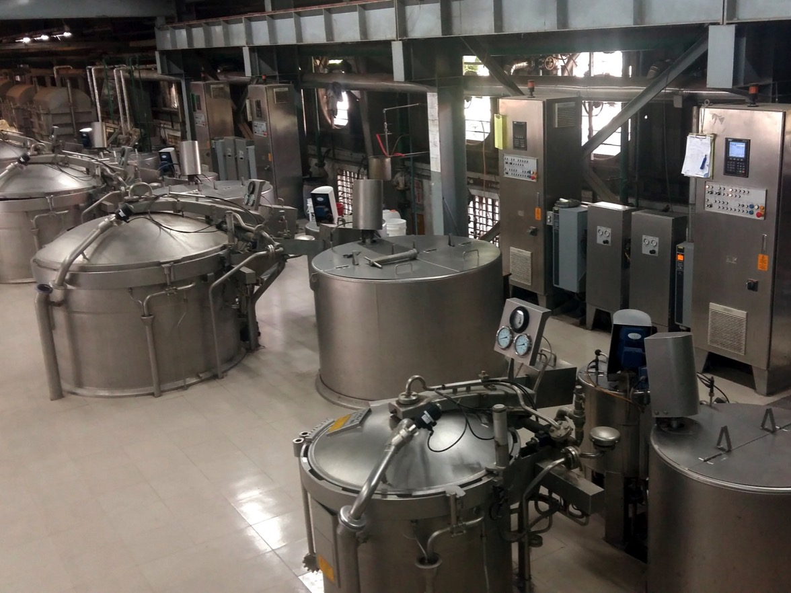
Dyeing Machines
Yarn Dyeing Unit

Slide 14
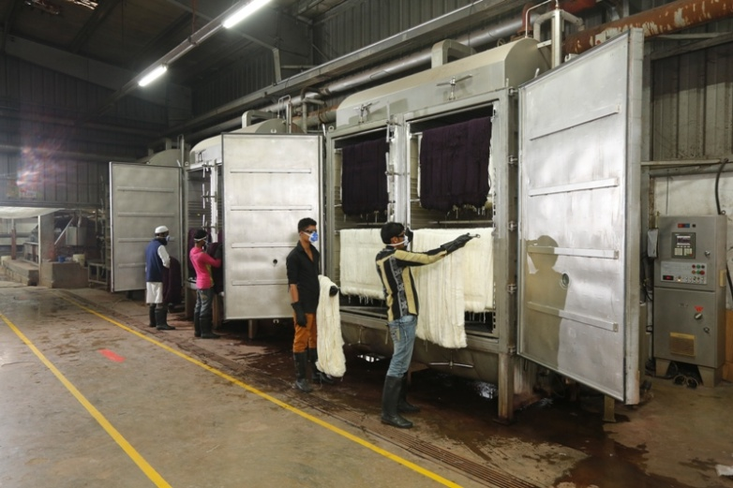
Dyeing Machines
Yarn Dyeing Unit

Slide 15
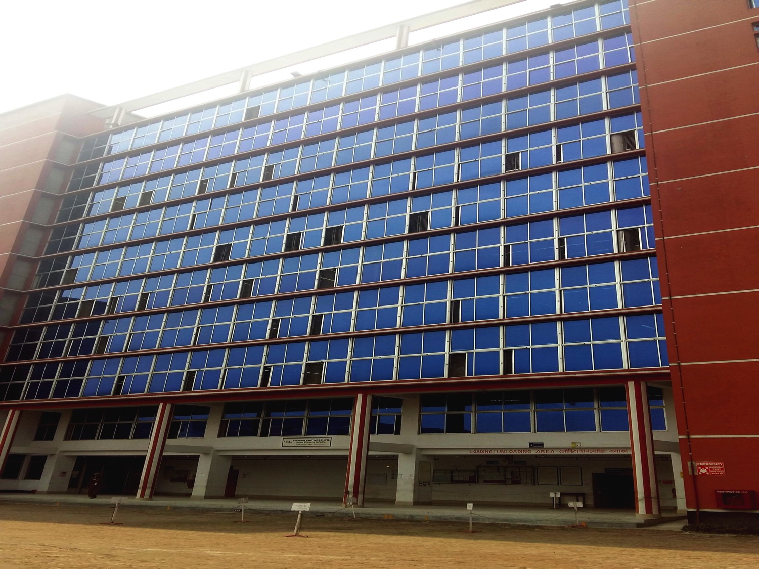




Factory Profile
Unit : Knit Garments Production
Product Category : Knitwear (Light Knits)
No. of Line : 45
Machineries : Pegasus - Japan
Brother - Japan
Juki – China
IMA - Italy

Slide 16
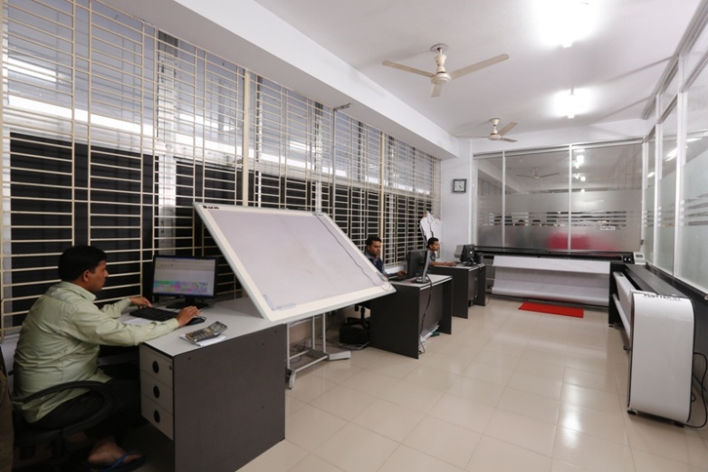
Cad Section
Knit Garments Production Unit

Slide 17
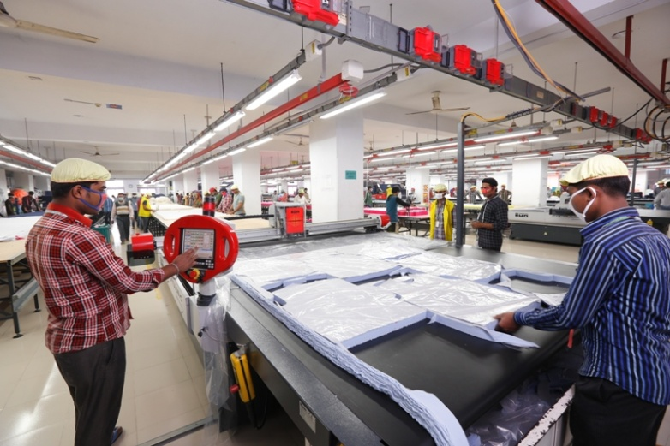
Automatic cutting machine
Knit Garments Production Unit

Slide 18
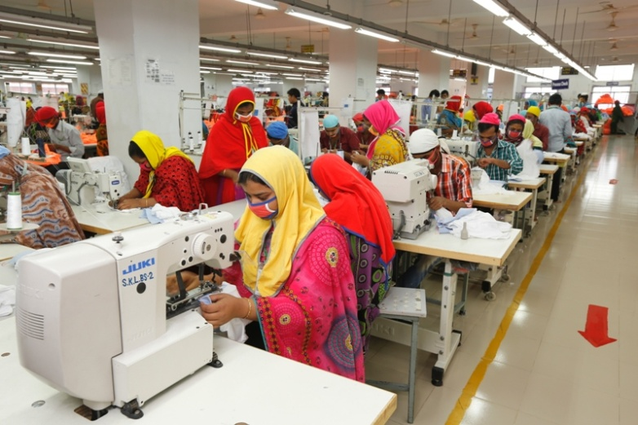
Sewing Lines
Knit Garments Production Unit

Slide 19
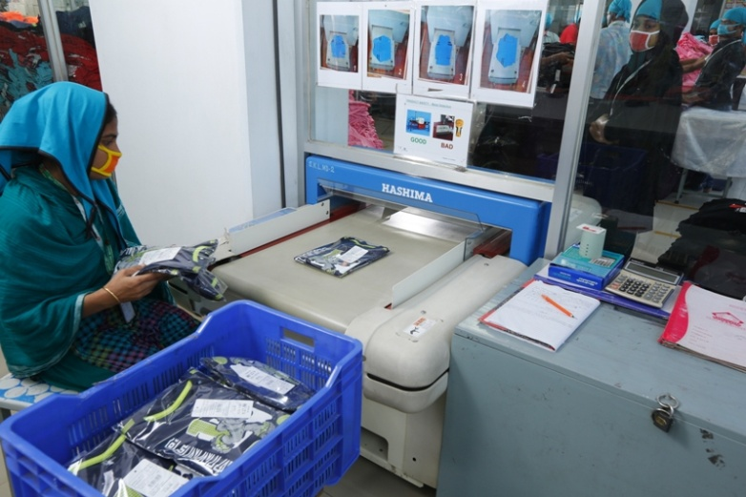
Garments passing through metal detection machine to the metal free zone
Knit Garments Production Unit

Slide 20
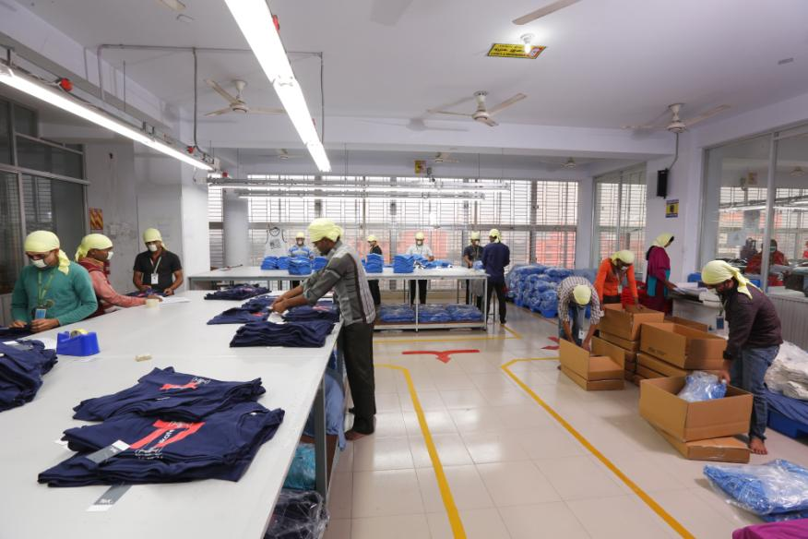
Packing
Knit Garments Production Unit

Slide 21


Factory Profile
Unit : Automatic Machine Printing
Product Category : All Types of Screen Print
No. of Machine : 6 Units
Machineries : M&R – USA
Ansal - Turkey

Slide 22
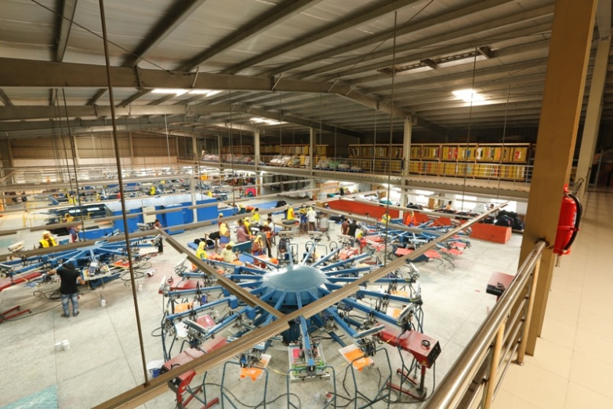
Top view
Automatic Machine Printing Unit

Slide 23


Factory Profile
Unit : All Over Fabric Printing
No. of Machine : 2 Unit
Machineries : Ichinose – Japan

Slide 24
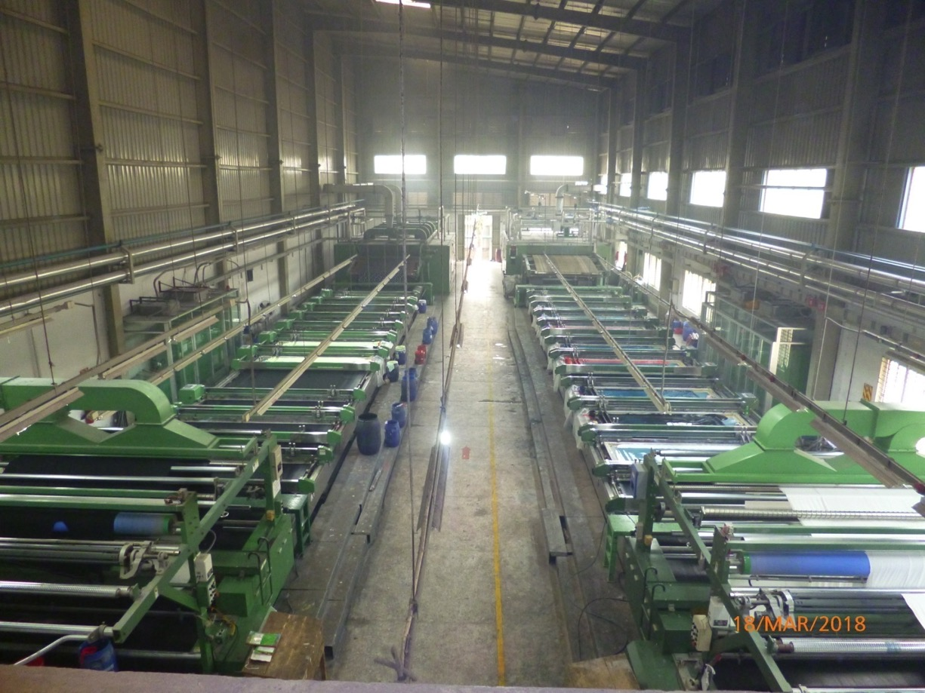
Top view
All Over Fabric Printing Unit

Slide 25
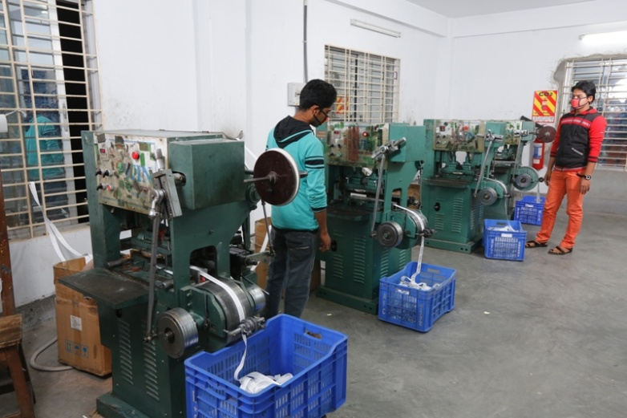
Factory Profile
Unit : Printed Labels
Product Category : Printed Satin & Paper Label
No. of Machine : Printed : 4 units
Machineries : RM Flying - China

Slide 26


Factory Profile
Unit : Packaging
Product Category : Corrugated Cartons
Poly bags
Hangtags
Elastic
Machineries : Hyplas - Taiwan
Heidelburg – Germany

Slide 27
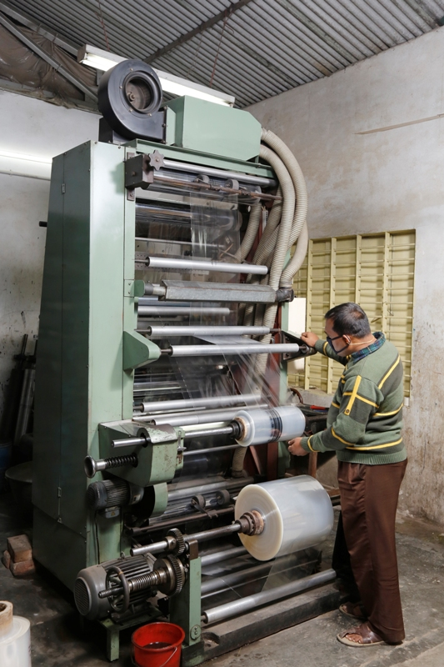
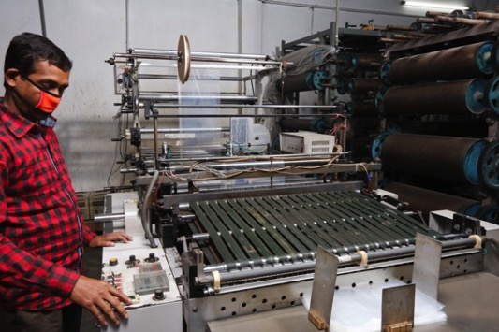
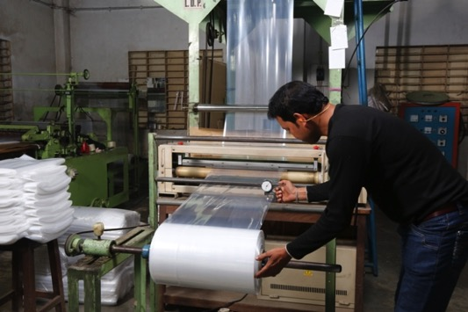
Poly Bag making Process
Packaging Unit

Slide 28
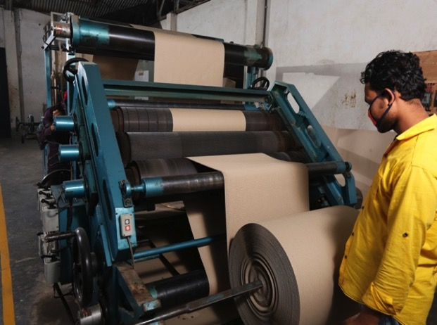
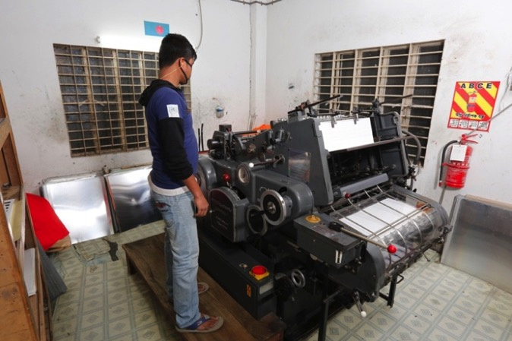
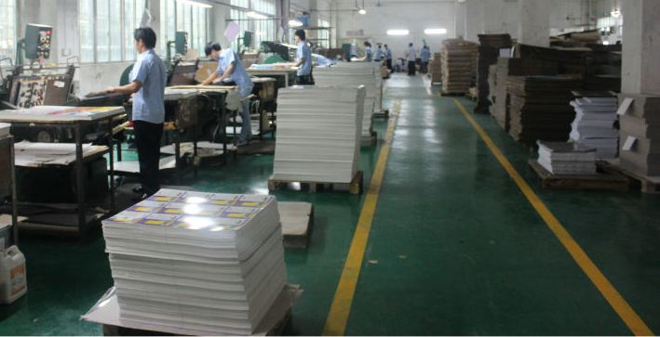
Offset Printing
Carton making processing
Packaging Unit

Slide 29

Factory Profile
Unit : Embroidery & Sewing Thread
Product Category : Embroidery, Sequin Attach, Appliqué
Sewing Thread
No. of Machine : 5 units
Machineries : Jintel-China

Slide 30
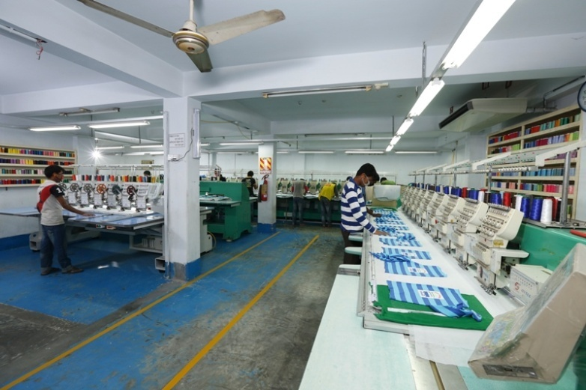
Embroidery Process
Embroidery & Sewing Thread Unit

Slide 31
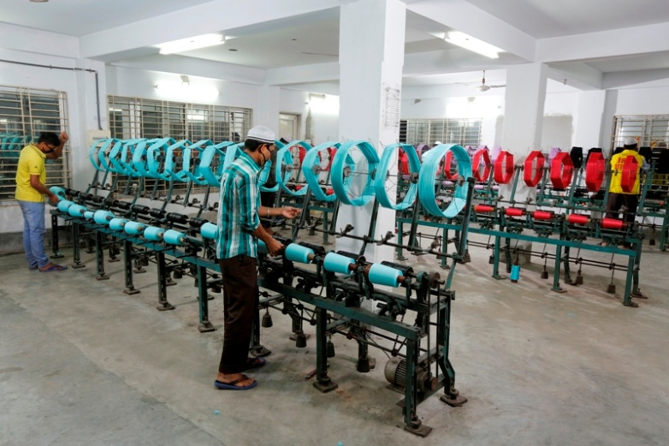
Thread winding
Embroidery & Sewing Thread Unit

Slide 32
Laboratory
Machineries : Spectro Photo Meter – Data color 650, Switzerland
Light Box – Verivide, UK
Crock Meter – Daelim Starlet, Korea
IR lab machine - Daelim Starlet, Korea
Tube less auto dispenser - MSI, Taiwan
Auto Solution maker - MSI, Taiwan
Light Fastness tester - Atlas, Germany
Washing – Siemens, Germany
Lab tumble dryer - Siemens, Germany
Lab Flat dryer - Daelim Starlet, Korea
Analytical Balance – CAS, Korea
Perspiration Meter - Atlas, Germany
Grey Scale – SDL, UK
GSM Cutter – Mesdan, Italy
Tumble Shrinkage Meter – James H Hill, Germany

Slide 33
Laboratory
Testing Facility: Color Fastness to light
Color Fastness to water
Color Fastness to rubbing
Color Fastness to perspiration
Fabric Bursting
Pilling
Dimensional Stability to washing
Fabric Spirality
Ph value
Fabric GSM
Yarn Count

Slide 34
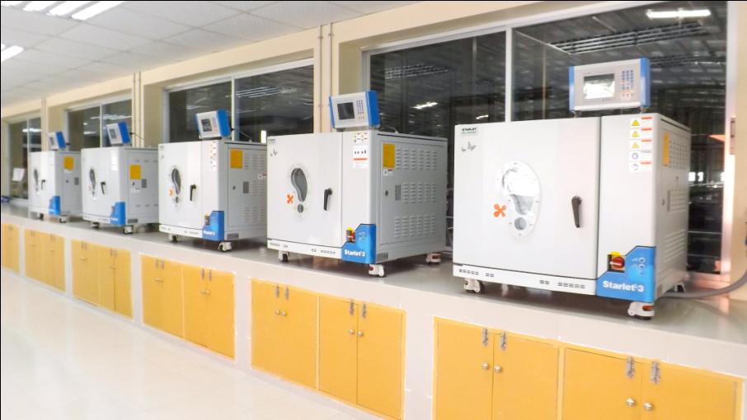
Laboratory

Slide 35
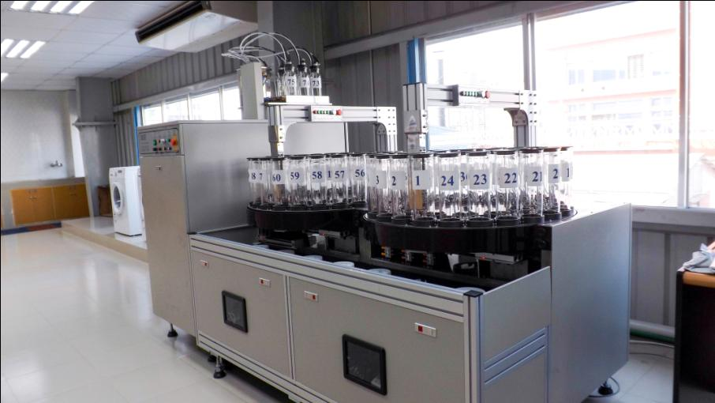
Laboratory

Slide 36
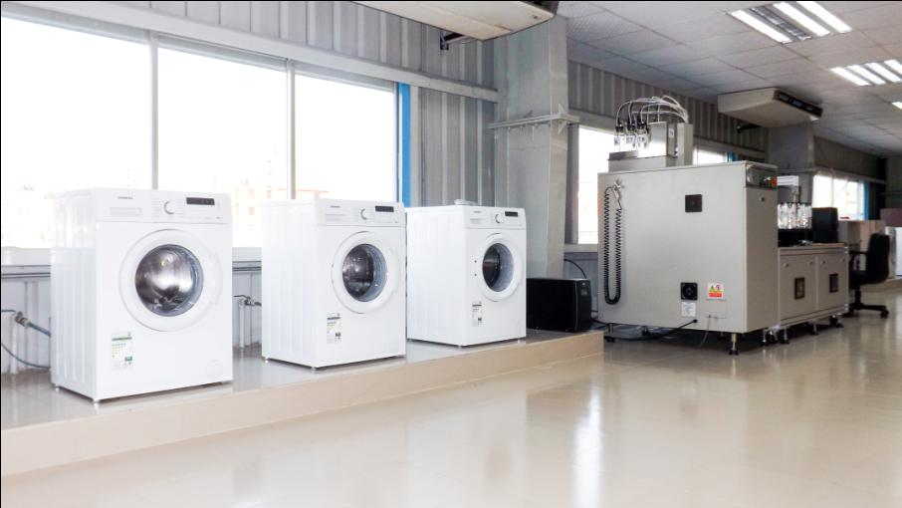
Laboratory

Slide 37
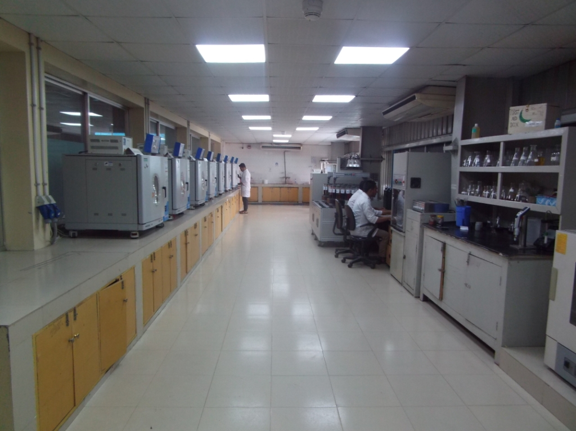
Laboratory

Slide 38
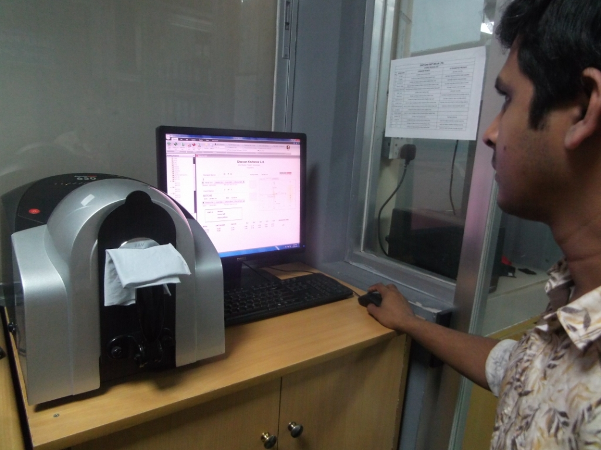
Data color processing
Laboratory

Slide 39
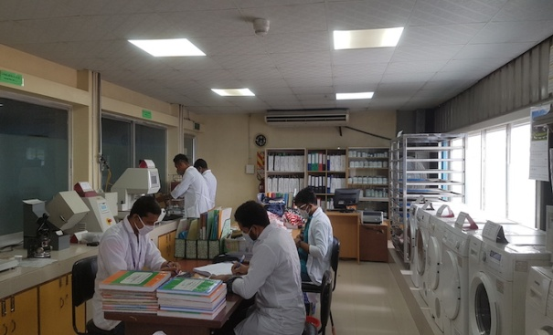
Testing Lab
Laboratory

Slide 40
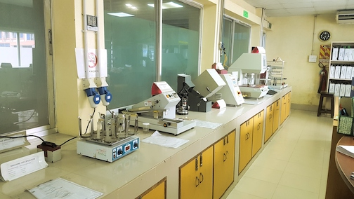
Lab Machines
Laboratory

Slide 41









Certifications / Accreditations
Knitwear
Audit Agency Audit Category/Type Reuslt
Accord Accord -Structural, Fire & Electrical safety 100%
S.G.S. BSCI-Social B
Eurofins ICS -Social 91%
TUV Technical/Process-Quality Management System Score 84
S.G.S. C-TPAT -Security Score 97
Hohenstein OEKO Tex -Human-Ecological Certified
USB Global Organic Textile Standard (GOTS) Certified
USB Organic Content Standard (OCS) Certified
USB Global Recycled Standard (GRS) Certified

Slide 42

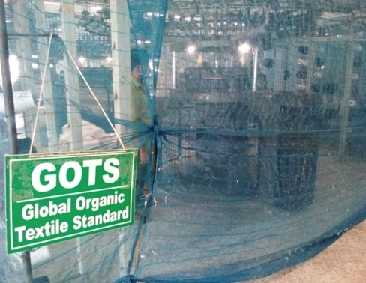
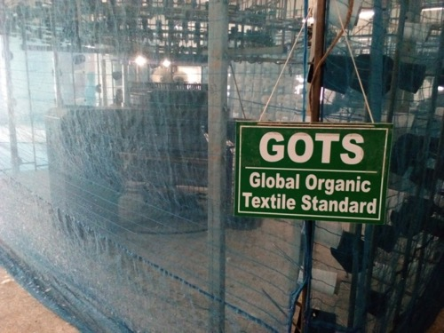
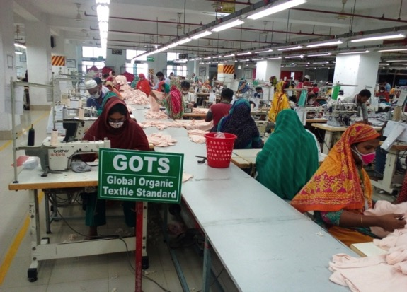
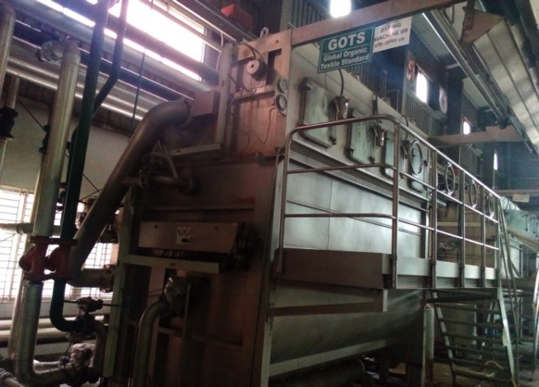
Certifications / Accreditations
GOT S

Slide 43
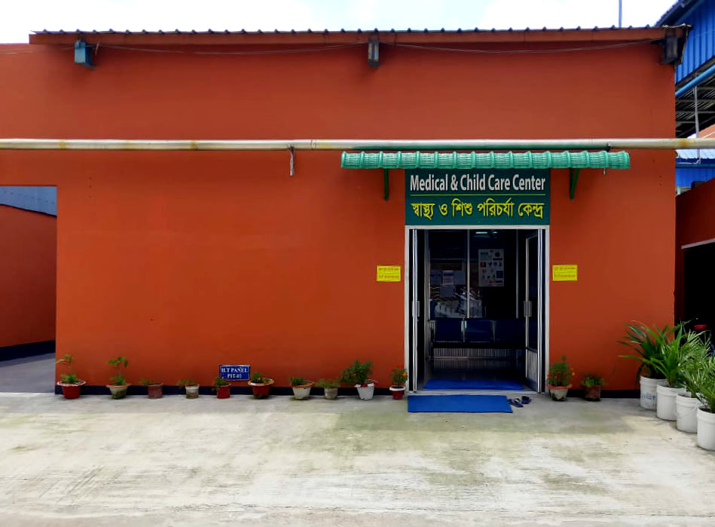
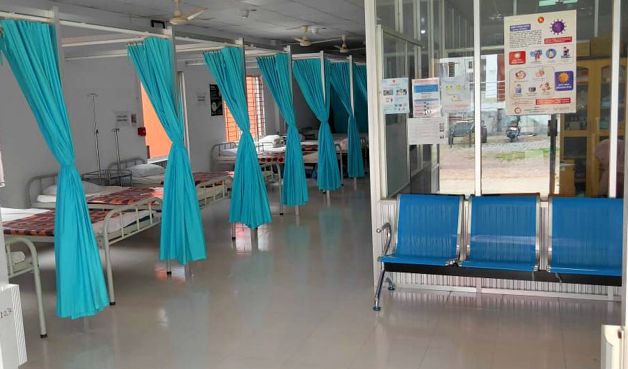
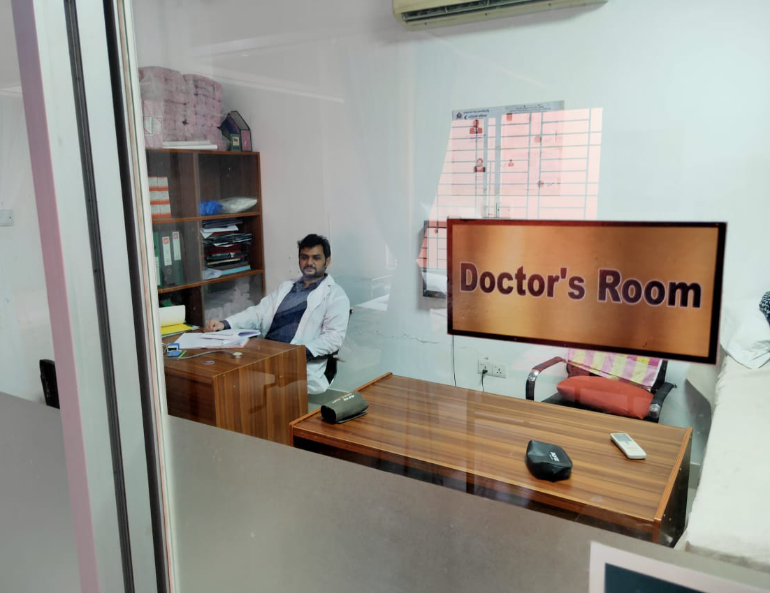
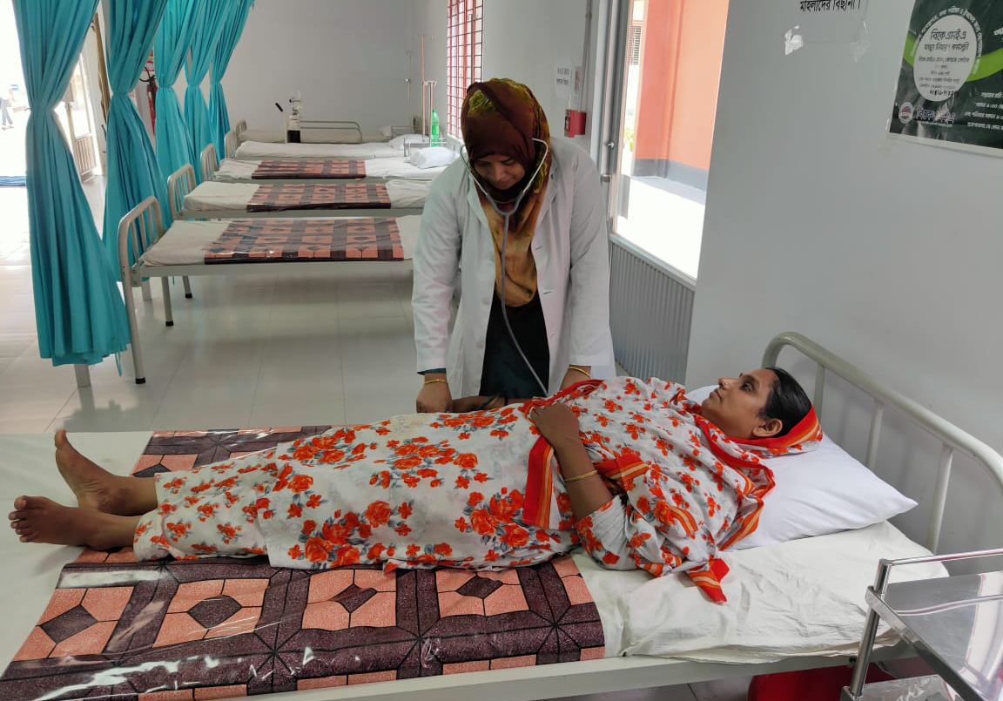
Full time Doctor & Nurse available on site
Welfare Facility

Slide 44
Health
&
Safety

Slide 45
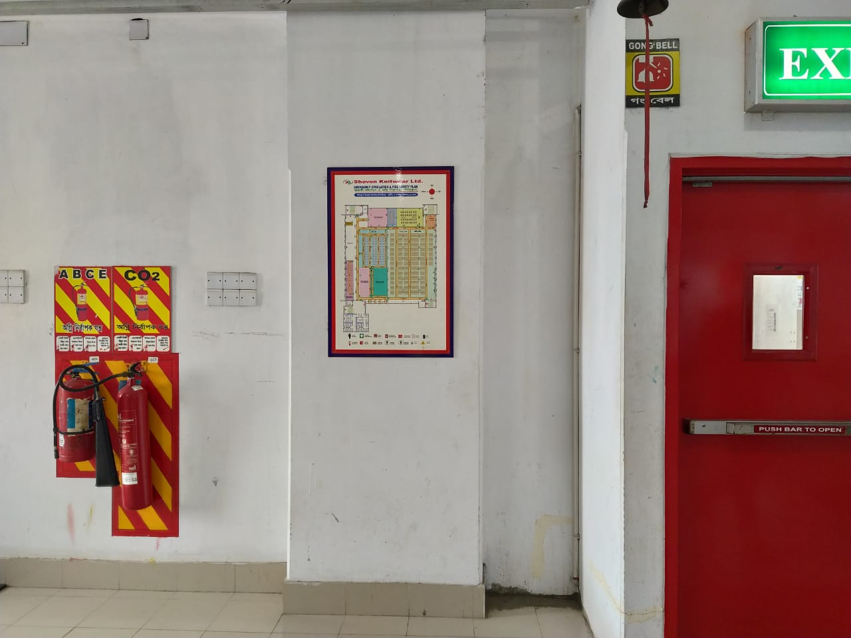
Evacuation Plan with necessary fire fighting equipments on each floor
Health & Safety

Slide 46
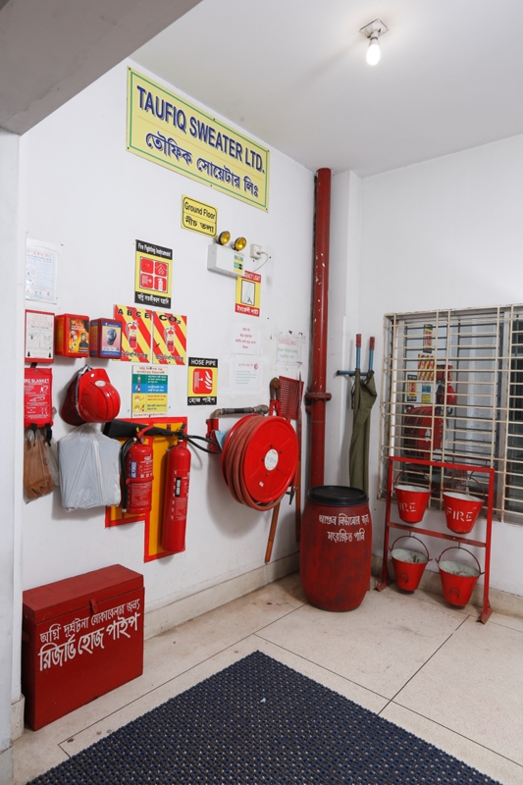
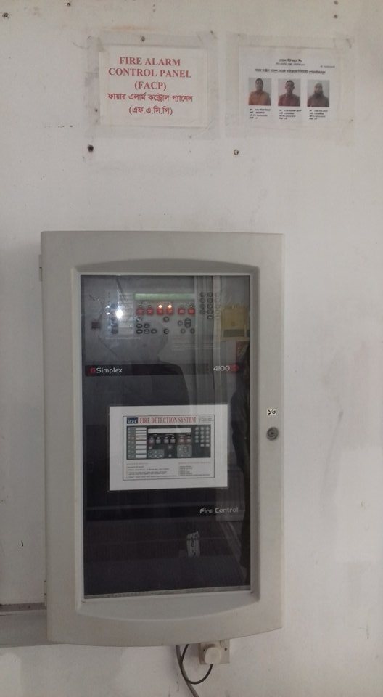
Fire Fighting equipments & Alarm Control Panel
Health & Safety
Health & Safety

Slide 47
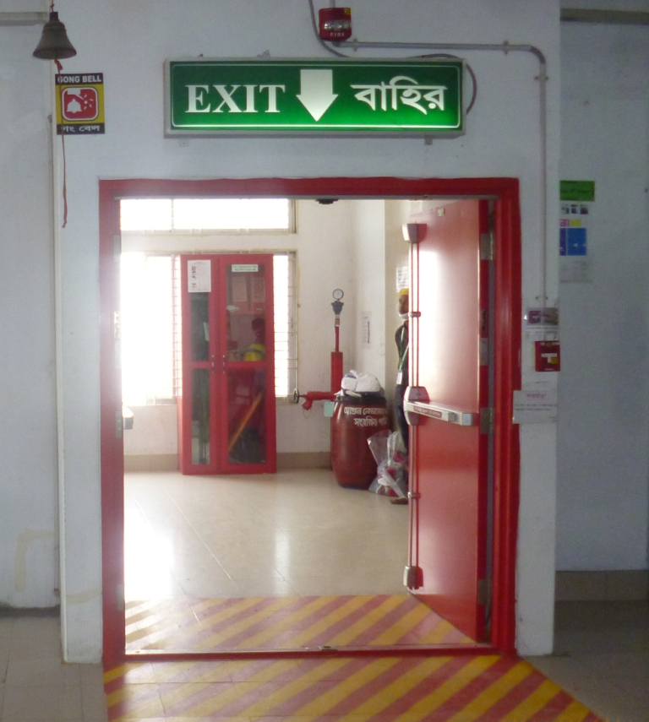
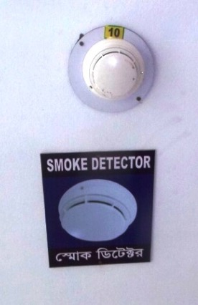
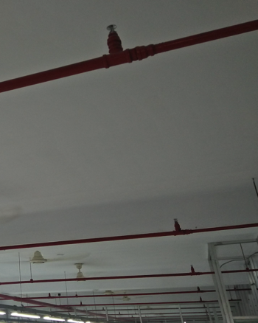
Fire Doors, Smoke Alarm & Sprinklers on each floor
Health & Safety
Health & Safety

Slide 48
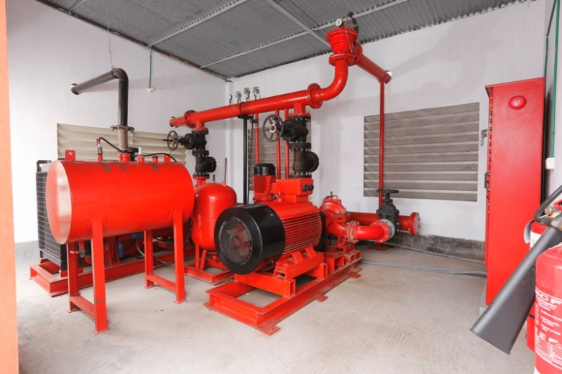
Central Fire Fighting system
Health & Safety

Slide 49
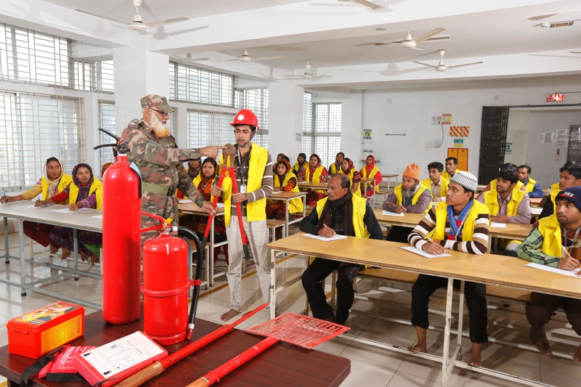
Fire Fighting Training done monthly
Health & Safety

Slide 50
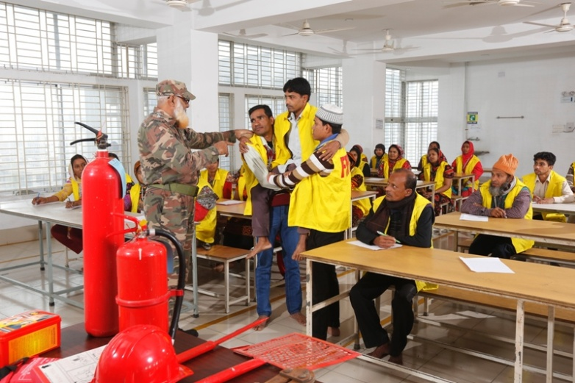
Fire Fighting Training done monthly
Health & Safety

Slide 51
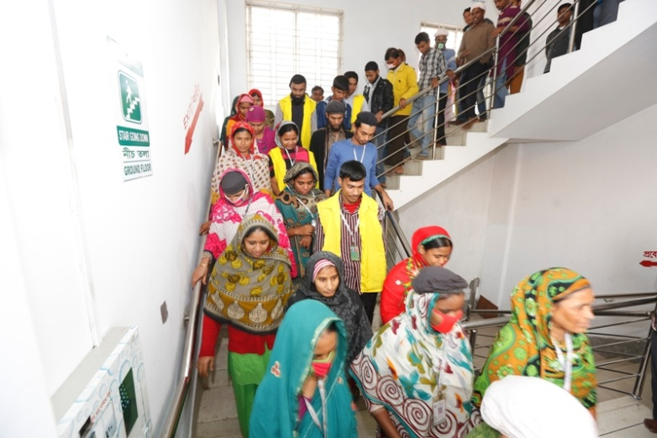
Fire Drill done monthly
Health & Safety

Slide 52

Fire Drill Assembly done monthly
Health & Safety

Slide 53

Clean Dinning Area
Health & Safety

Slide 54

Canteen
Health & Safety

Slide 55

Drinking water purification system
Health & Safety

Slide 56

Pure Drinking water Available on each floor
Health & Safety

Slide 57
Management
System

Slide 58

Electronic Attendance & Payroll System ensuring workers transparent salary.
Management System

Slide 59

Electronic Attendance & Payroll System ensuring workers transparent salary.
Management System

Slide 60

Notice Board allowing workers to aware about company policy & labor law.
Management System

Slide 61

Security Checking before loading goods for shipping
Management System

Slide 62

Environment Management System Training done monthly on several subject
Management System

Slide 63

New Worker Orientation done after recruitment
Management System

Slide 64

Workers Participation Committee Meeting done every two months
Management System

Slide 65

Security Awareness Training quarterly
Management System

Slide 66


First Aid Training done every two months
Management System

Slide 67
Corporate Social Responsibility
Shovon Group of Companies adopted cleaner and improved technology and management for better environment in order to achieve its goals. Considering the buyers demand and requirements, implementing the guidelines from the world-renowned organizations for eco-friendly production.
The sustainable developments are:
Cleaner water and sanitation
Affordable and clean energy
Innovation infrastructure
Climate action and responsible consumption and production
Environmental sustainability consists of energy usage, water usage and chemical storage and handling
Using sustainable yarn like organic, bamboo and banana
Using recycled yarns
Tree plantation on production plant
Waste water treatment plant
Re use of water
Re use of waste steam
Condensate recovery boiler
Water efficient dyes and chemicals
Use of renewable energy (solar panel)
Prismatic skylight
T5 and LED light
Sustainability reporting and etc.
Resources efficiency
Energy efficiency → Reducing energy usage → Maximize alternative energy resources
Water efficiency → Reducing water usage → Maximize alternative water supply
Material efficiency → Optimizing material flow and usage → Manage inventory and procurement

Slide 68

Water Softening Plant: water treated to minimize the hardness before consuming for dyeing process to reduce chemical consumption.
Corporate Social Responsibility

Slide 69



Effluent Treatment Plant: Water released form the dyeing house goes to the Effluent Treatment Plant. Highly advanced “Elector Contaminant Removal” plant removes all hazardous ingredients from the waste water. Advanced aeration system maintains Dissolved Oxygen level in water to its target parameters before discharged to sewerage.
Corporate Social Responsibility

Slide 70

Monitoring water consumption: To minimize water consumption several flow meters are installed & the record kept periodically.
Corporate Social Responsibility

Slide 71

BBT system: Bus Bar Tranking system are installed to minimize voltage drop and consumes less electricity. It is also safe from electrical short circuit & fire hazard.
Corporate Social Responsibility

Slide 72




TREE PLANTATION
Corporate Social Responsibility

Slide 73
_{A D D R E S S}
West Masdair, Fatullah, Narayanganj.1400
_{Bangladesh}
_{Call : + 88-09611-677395}
_{E-mail}
_{info@shovongroup-bd.com}
_{Web}
_{www.shovongroup-bd.com}
_{Bank}
_{Dutch Bangla Bank Limited}
Narayanganj Branch, Narayanganj, Bangladesh
_{Prime Bank Limited}
Narayanganj Branch, Narayanganj, Bangladesh
_{The} _{City Bank Limited}
Narayanganj Branch, Narayanganj, Bangladesh

