Slide 1
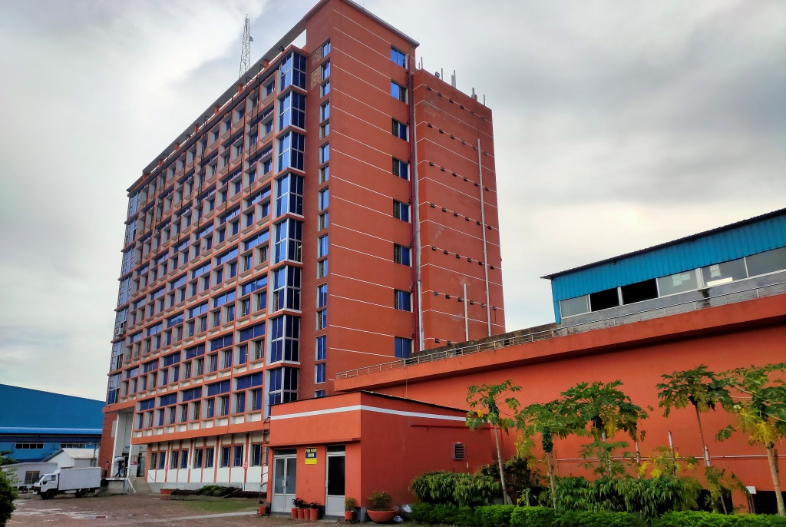

    T A U F I Q S W E A T E R L I M I T E D
    S I N C E - 2001

Slide 2
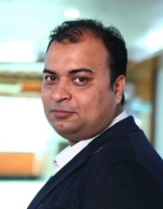
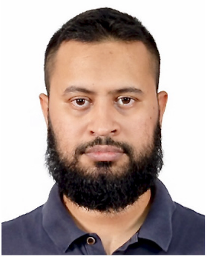
Key Persons
Iqbal Yousuf Shovon
Managing Director
Taufiqul Islam Antu
Director

Slide 3




Our Concern
Sweater Division
-Yarn Dyeing Unit
-Sweater Production Unit
-Winding section
-Knitting Section
-Linking Section
-Trimming & Mending Section
- Ironing, Packing
Yarn Dyeing Division
-Yarn Dyeing unit
Packaging & Accessories Division
-Printed Labels & Tag Unit
-Packaging Unit
-Poly Unit

Slide 4
Why Choose Our Products ?
•
Quality Assurance
•
Resilient Performance
•
On Time Delivery
•
Competitive Prices
•
Better Communication

Slide 5






Existing Customers

Slide 6

Factory Profile
Unit : Yarn Dyeing
Product Category : Acrylic, Cotton, 50/50 Cot/Acr,
No. of Machine : Dyeing- 03 units, Dryer - 02 unit,
Hydro – 03, Packing – 01.
Machineries : Fongs– China
Fadis -Italy

Slide 7
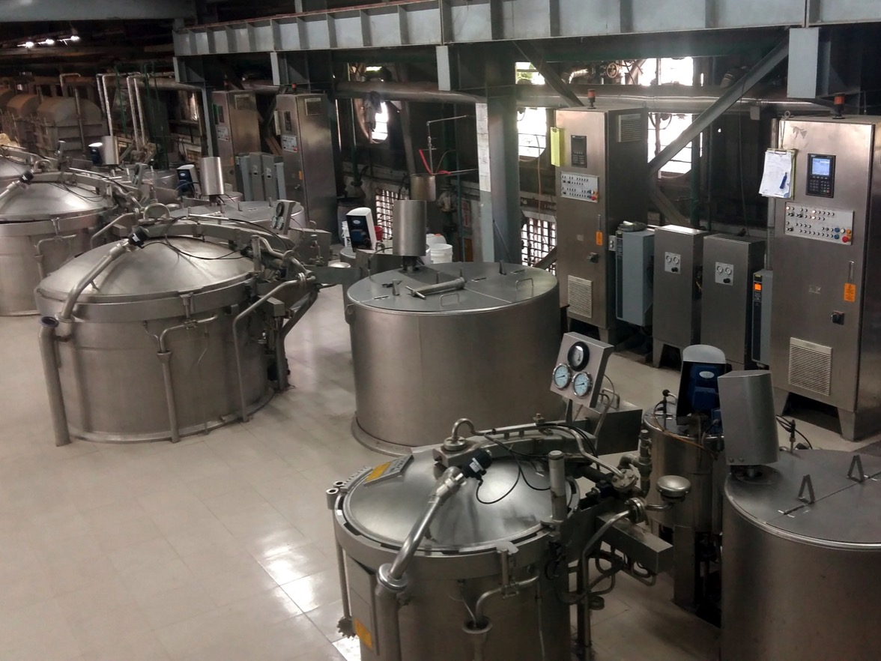
Dyeing Machines
Yarn Dyeing Unit

Slide 8


Factory Profile
Unit : Sweater Production
Product Category : All Kinds of Heavy Knitwear
No. of Machine : Knitting Machine :
Multi gg Automatic Jacquard – 300 units
Machineries : Shima Seiki – Japan
Stoll - Germany

Slide 9
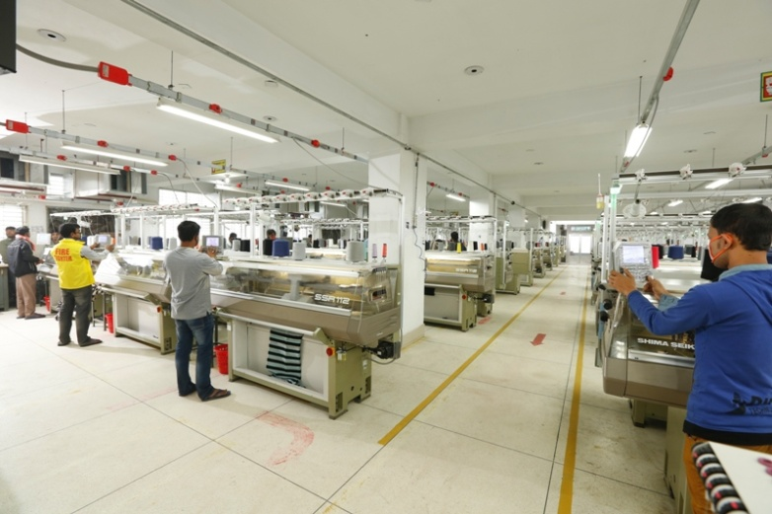
Knitting Processing Floor
Sweater Production Unit

Slide 10
Laboratory
Machineries : Spectro Photo Meter – Data color 650, Switzerland
Light Box – Verivide, UK
Crock Meter – Daelim Starlet, Korea
IR lab machine - Daelim Starlet, Korea
Tube less auto dispenser - MSI, Taiwan
Auto Solution maker - MSI, Taiwan
Light Fastness tester - Atlas, Germany
Washing – Siemens, Germany
Lab tumble dryer - Siemens, Germany
Lab Flat dryer - Daelim Starlet, Korea
Analytical Balance – CAS, Korea
Perspiration Meter - Atlas, Germany
Grey Scale – SDL, UK
GSM Cutter – Mesdan, Italy
Tumble Shrinkage Meter – James H Hill, Germany

Slide 11
Laboratory
Testing Facility: Color Fastness to light
Color Fastness to water
Color Fastness to rubbing
Color Fastness to perspiration
Fabric Bursting
Pilling
Dimensional Stability to washing
Fabric Spirality
Ph value
Fabric GSM
Yarn Count

Slide 12
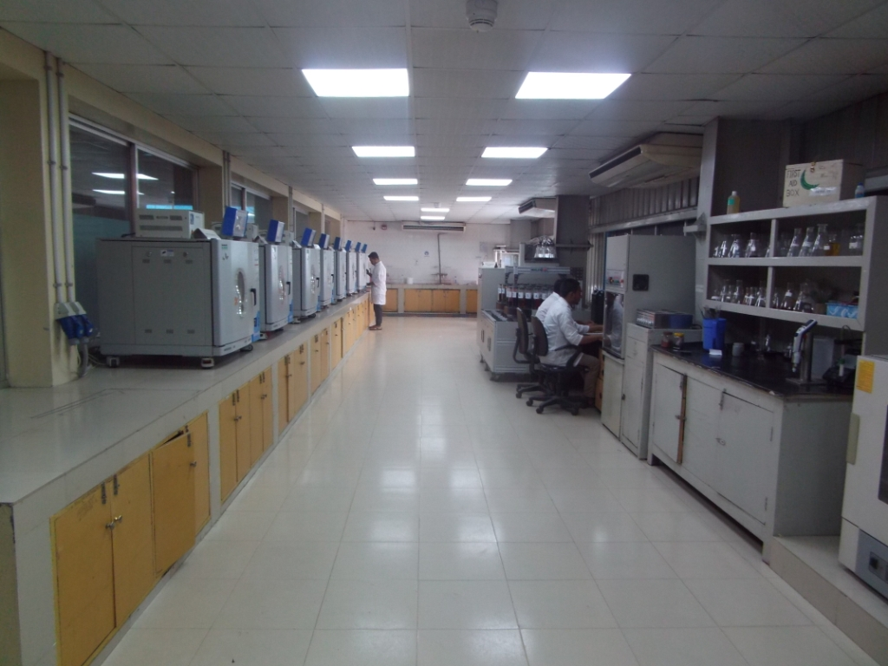
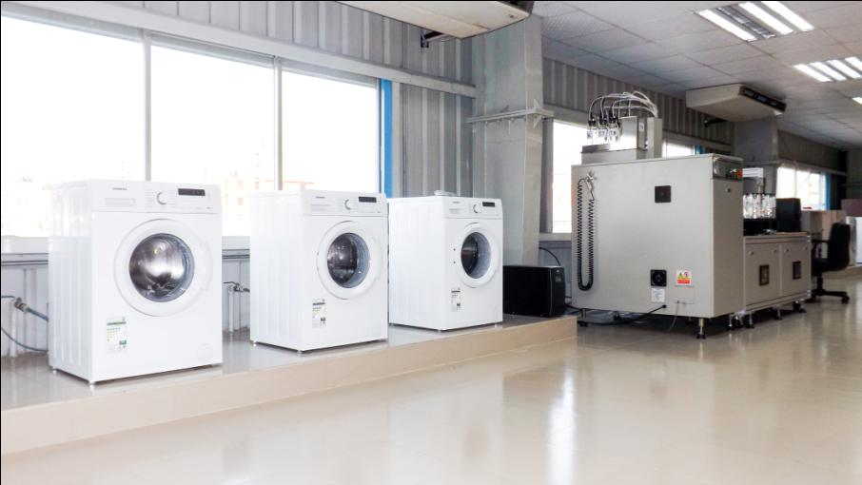
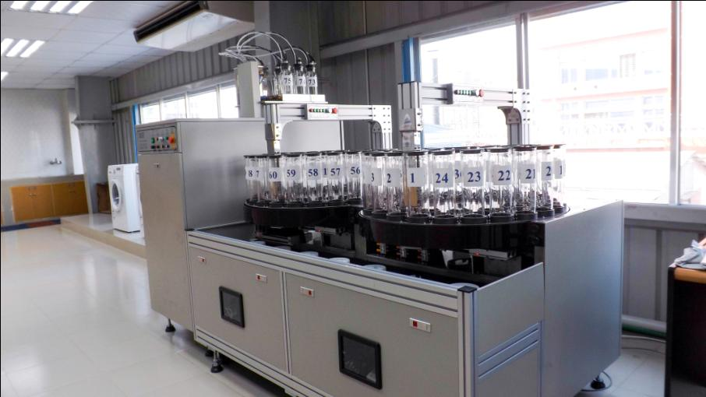
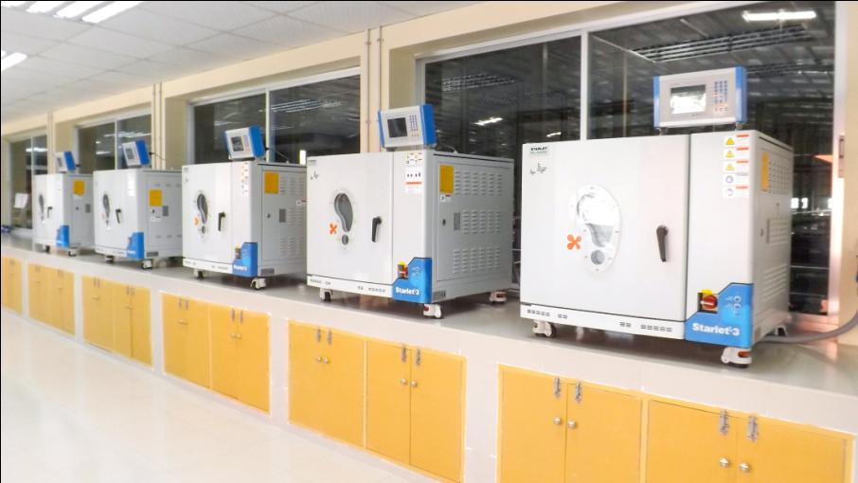
Laboratory

Slide 13
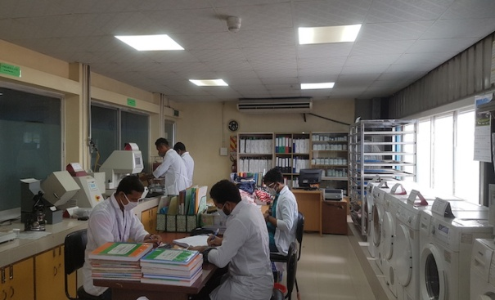
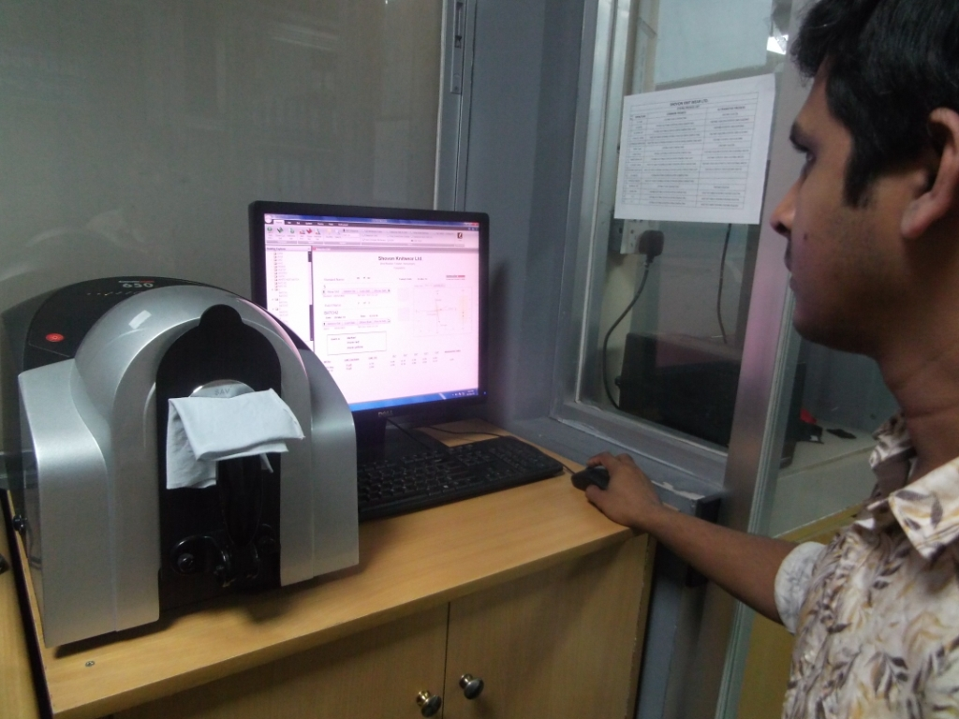
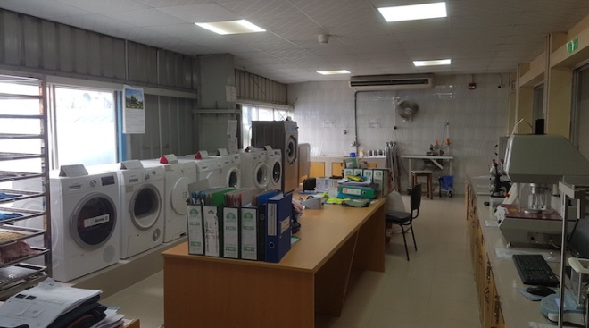
Testing Lab
Data color processing
Testing Lab
Laboratory

Slide 14











Certifications / Accreditations
Sweater
Audit Agency Audit Category/Type Reuslt
Alliance Structural, Fire & Electrical safety 100%
RSC Structural, Fire & Electrical safety 100%
(Formerly Accord) (Recognition letter received)
I.T.S. Amfori BSCI- Social B
AiTex OEKO-TEX (Standard 100) Certified
ITS Global Organic Textile Standard (GOTS) Certified
ITS Organic Contenet Standard (OCS) Certified
GSCS Global Recycled Standard (GRS) Certified
GSCS Recycled Claim Standard( RCS) Certified
TUV Technical/Process-Quality Management System Score 99
Self Higg Index Fem 3.0 62 %
Eco -Vadis Self Assessment --- Social & Environmental 45%
Amfor BEPI Self Assessment

Slide 15
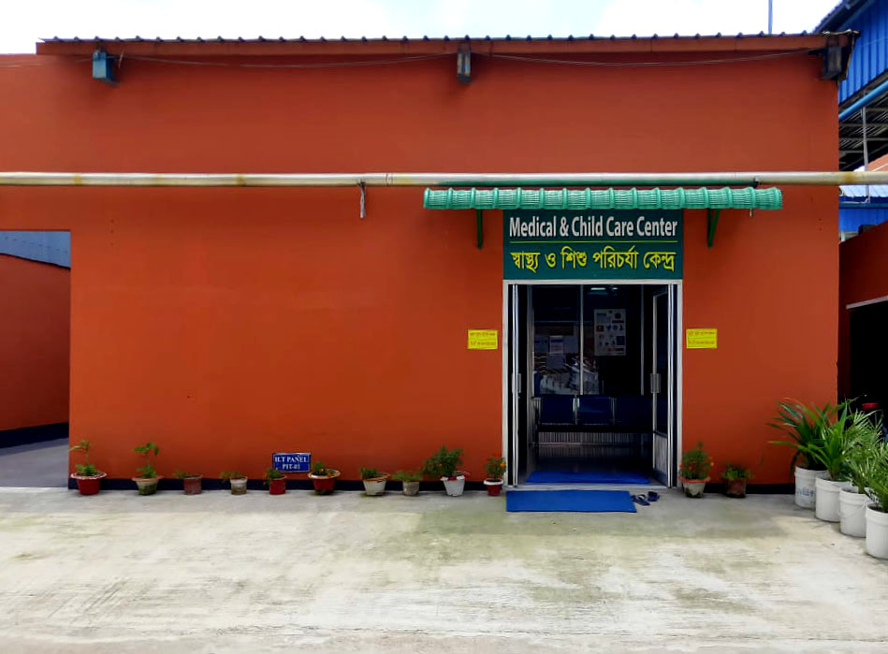
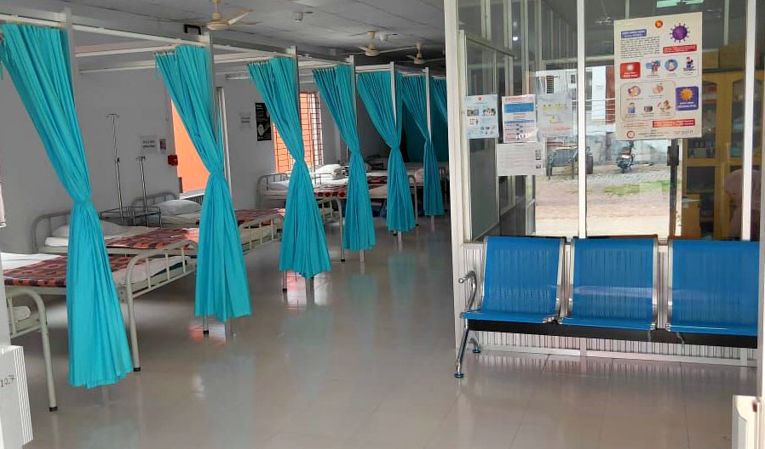
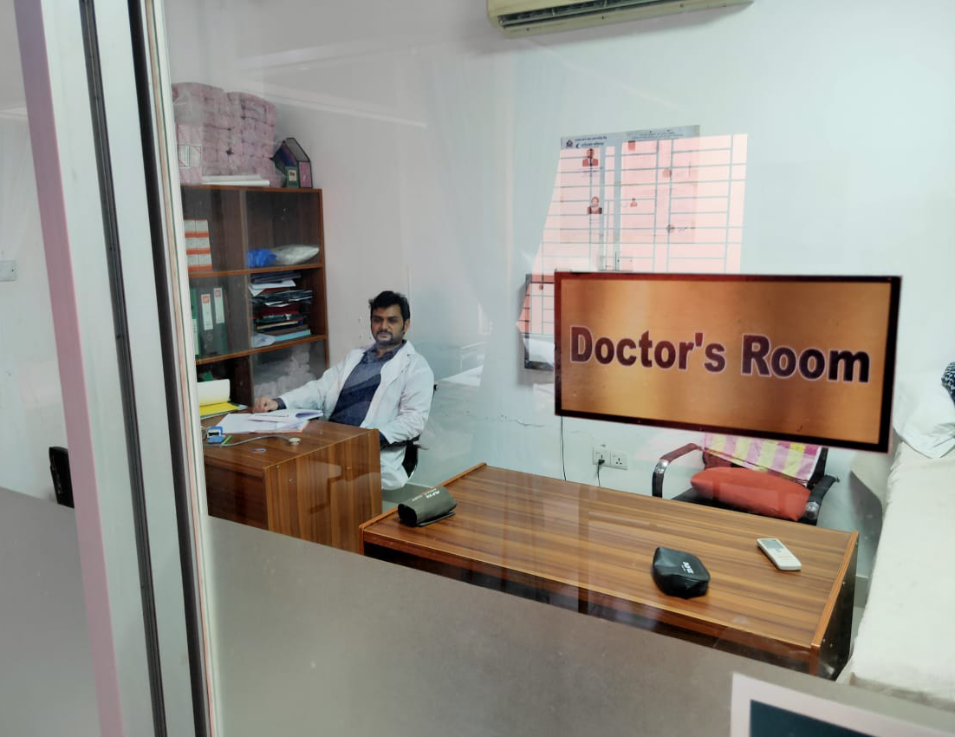
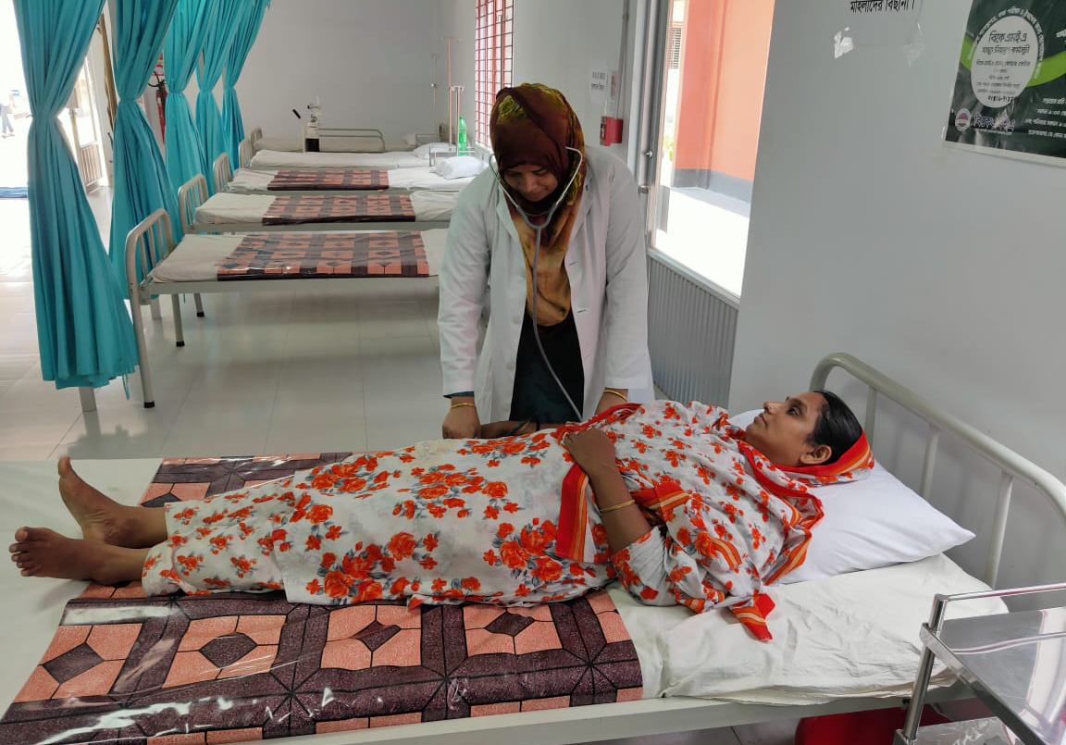
Full time Doctor & Nurse available on site
Welfare Facility

Slide 16
Health
&
Safety

Slide 17
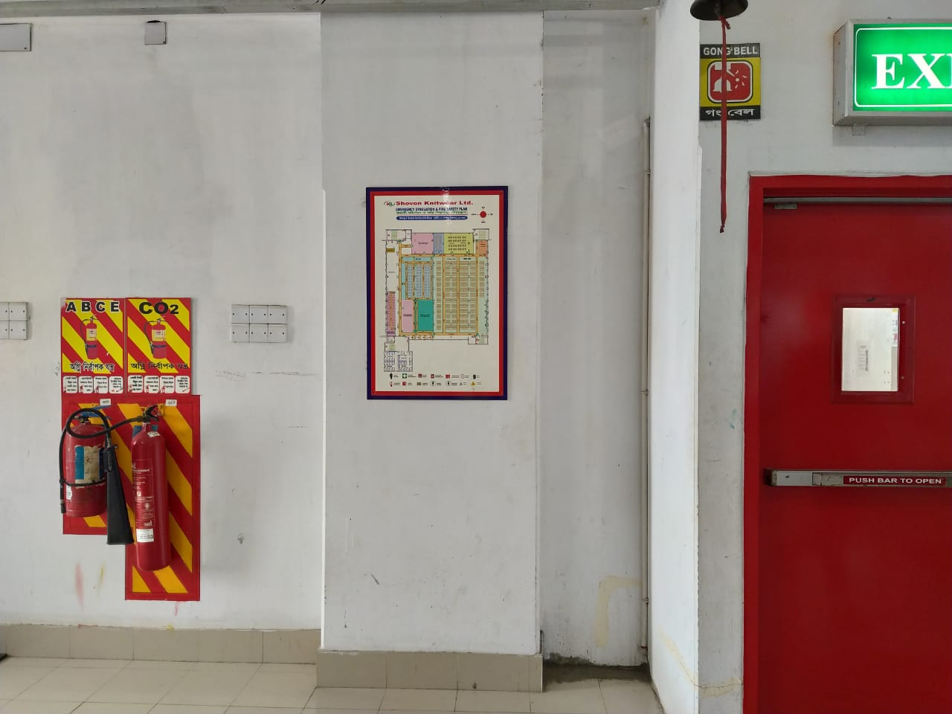
Evacuation Plan with necessary fire fighting equipments on each floor
Health & Safety

Slide 18
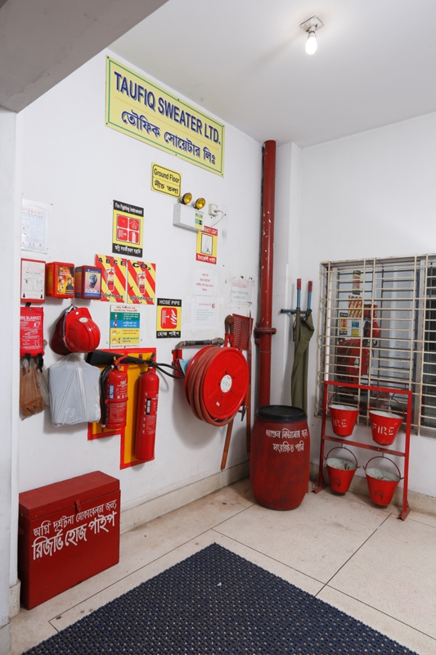
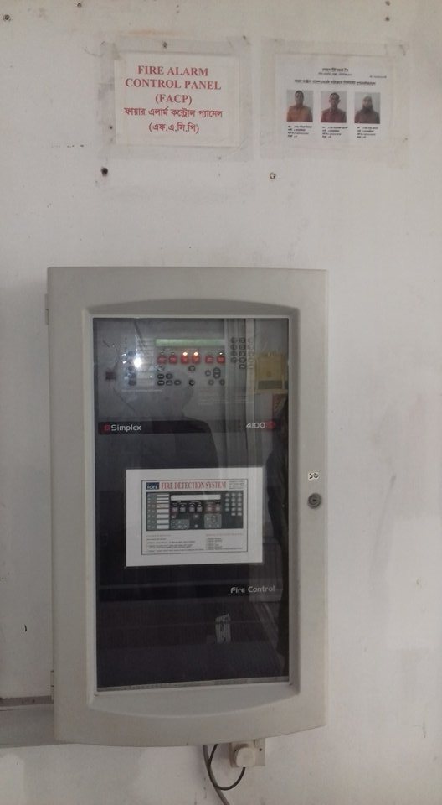
Fire Fighting equipments & Alarm Control Panel
Health & Safety
Health & Safety

Slide 19
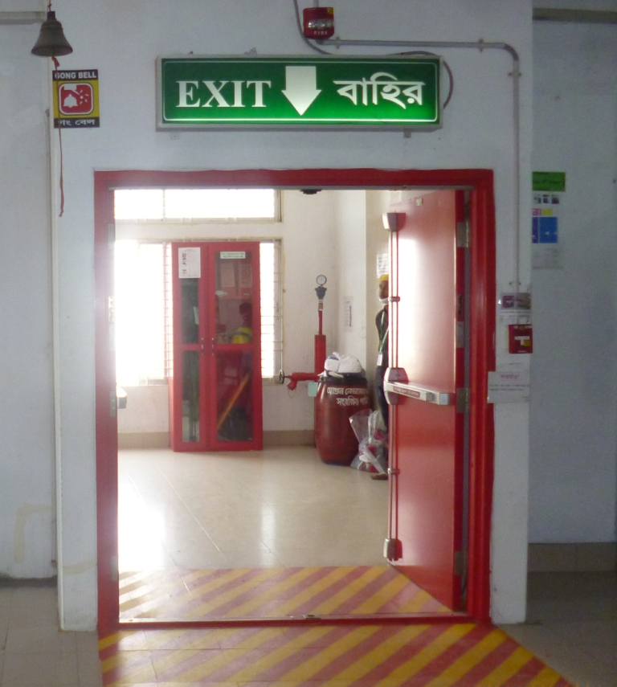
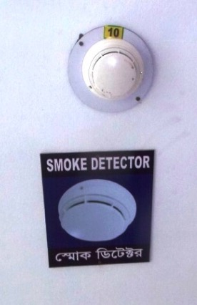
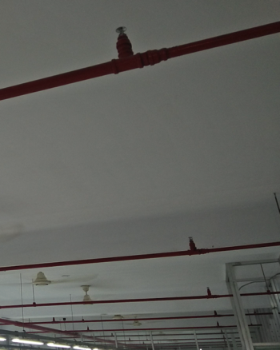
Fire Doors, Smoke Alarm & Sprinklers on each floor
Health & Safety
Health & Safety

Slide 20
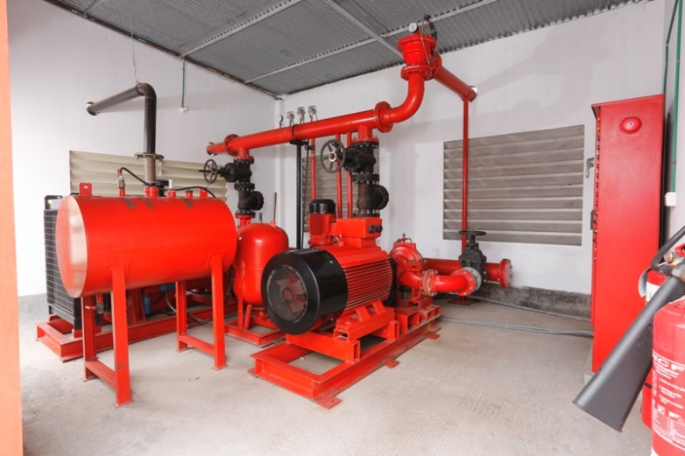
Central Fire Fighting system
Health & Safety

Slide 21
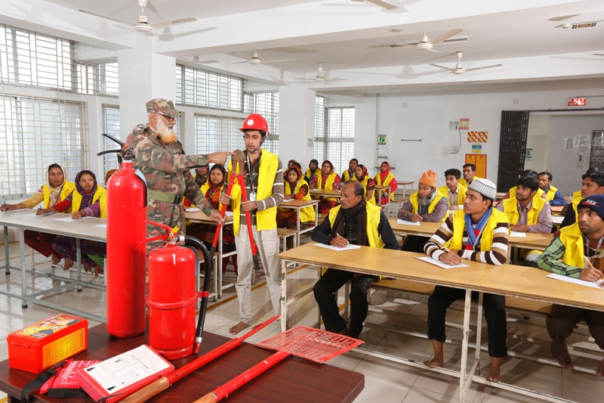
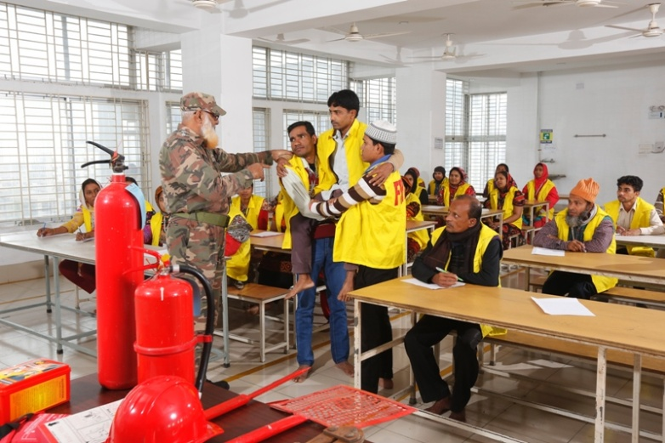
Fire Fighting Training done monthly
Health & Safety

Slide 22
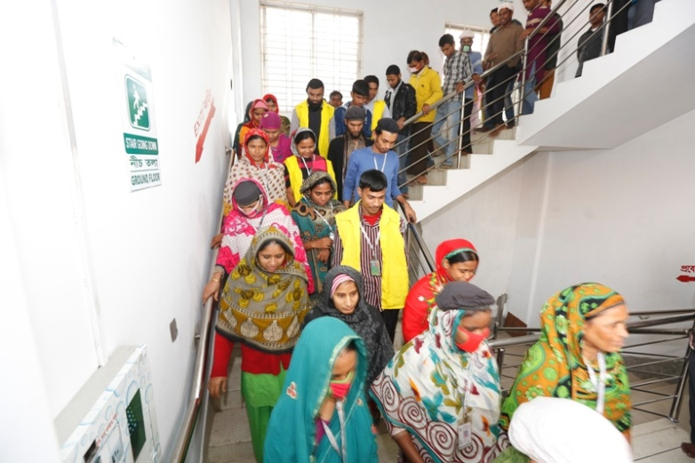
Fire Drill done monthly
Health & Safety

Slide 23
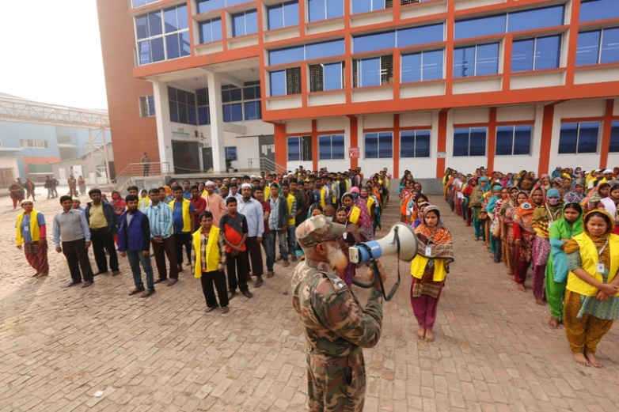
Fire Drill Assembly done monthly
Health & Safety

Slide 24
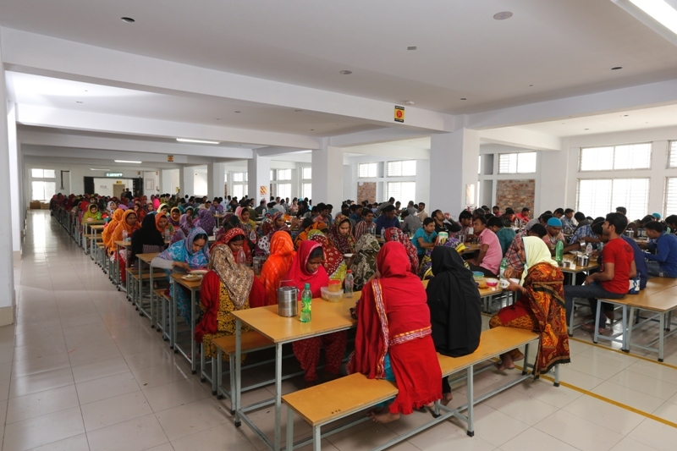
Clean Dinning Area
Health & Safety

Slide 25
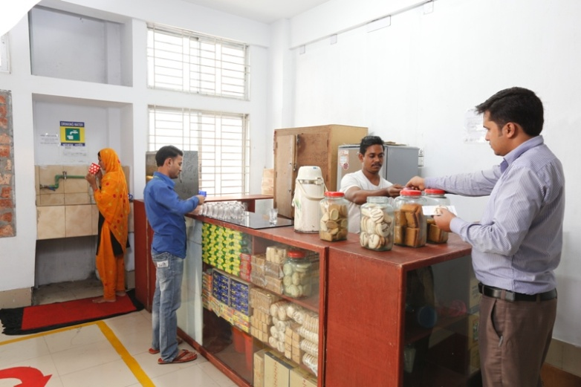
Canteen
Health & Safety

Slide 26
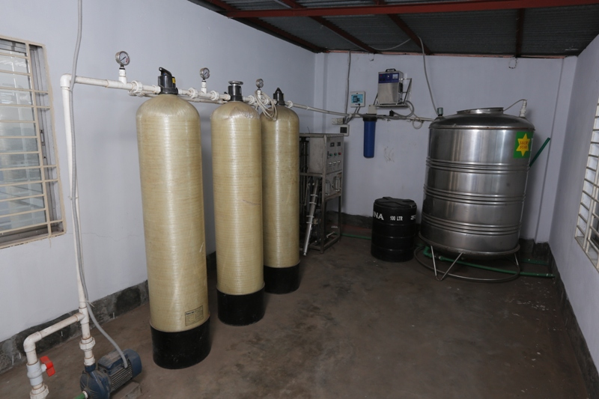
Drinking water purification system
Health & Safety

Slide 27
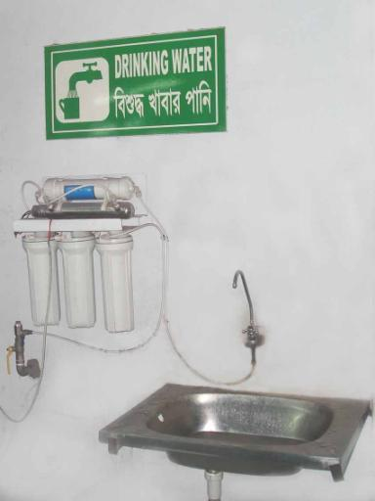
Pure Drinking water Available on each floor
Health & Safety

Slide 28
Management
System

Slide 29
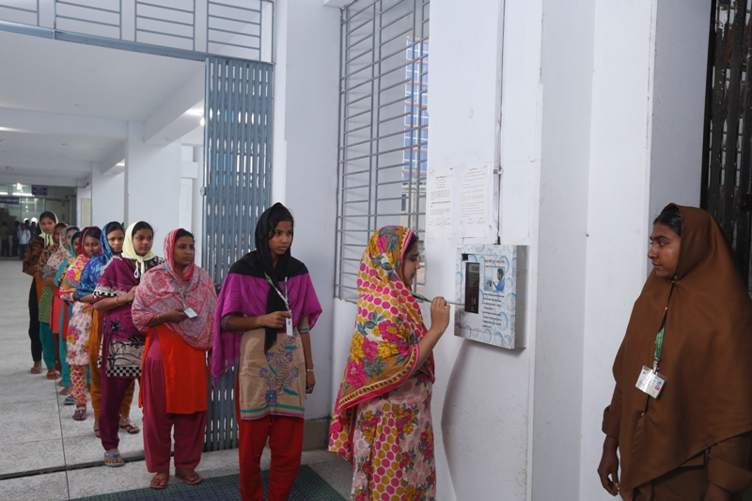
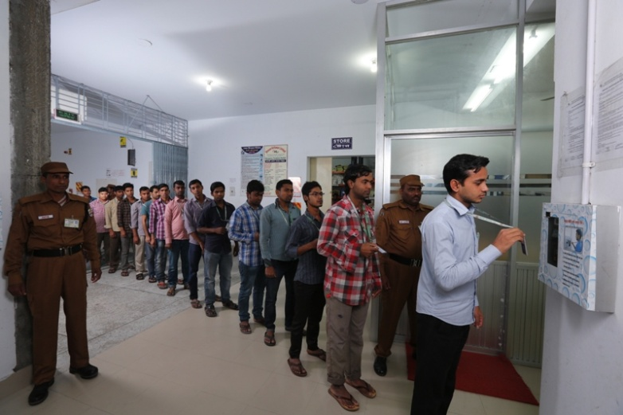
Electronic Attendance & Payroll System ensuring workers transparent salary.
Management System

Slide 30
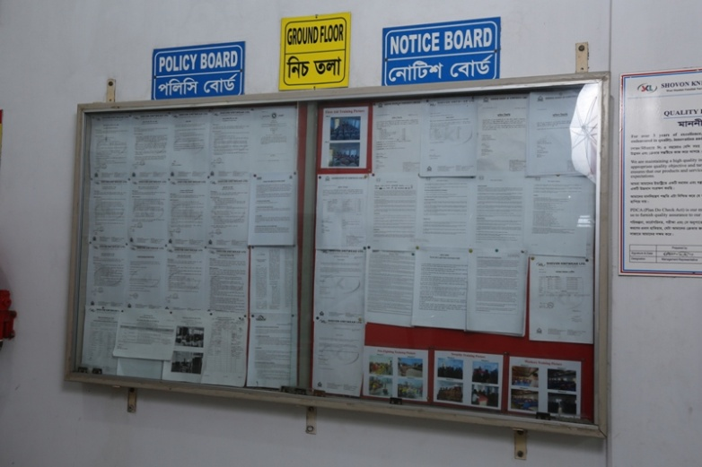
Notice Board allowing workers to aware about company policy & labor law.
Management System

Slide 31
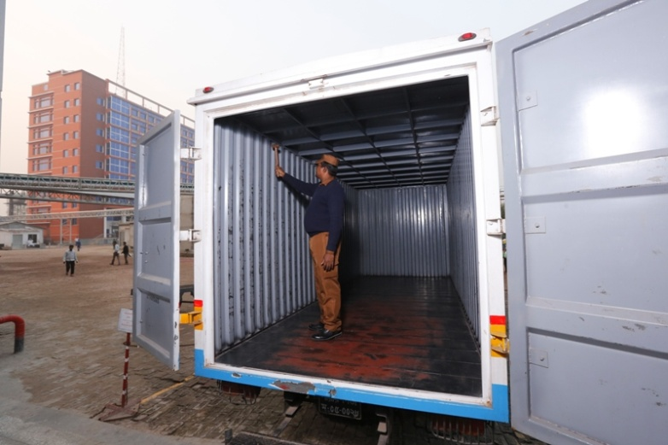
Security Checking before loading goods for shipping
Management System

Slide 32
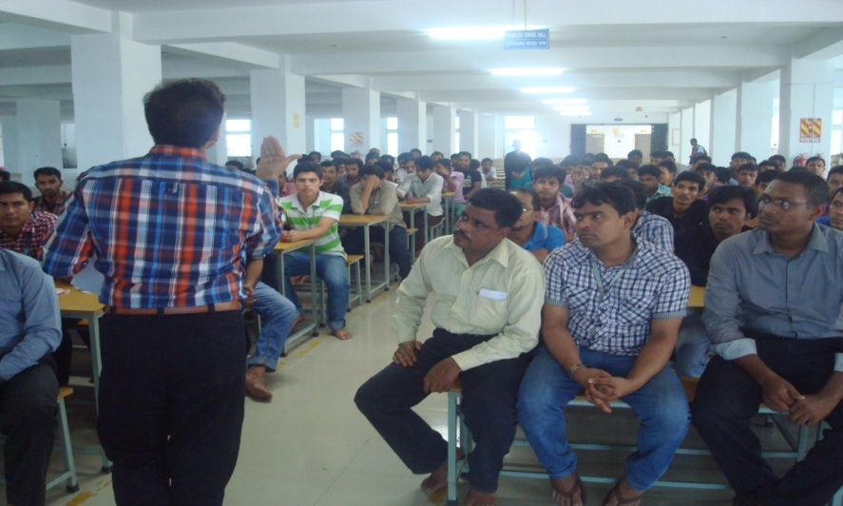
Environment Management System Training done monthly on several subject
Management System

Slide 33
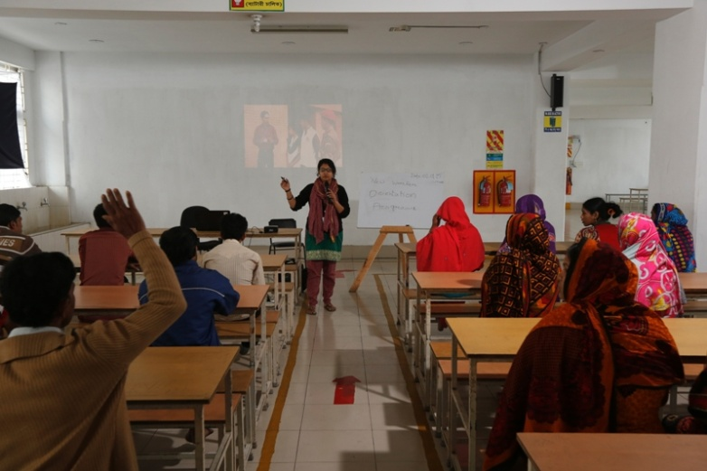
New Worker Orientation done after recruitment
Management System

Slide 34
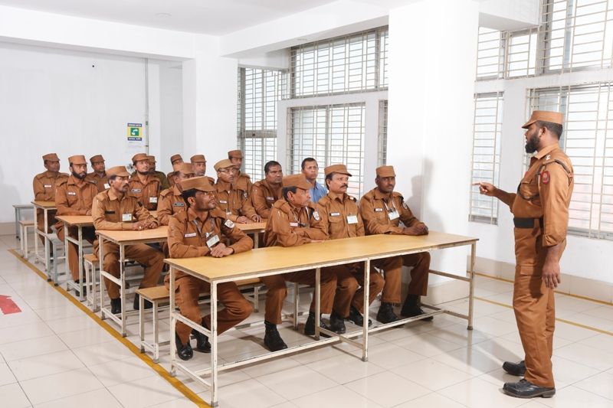
Security Awareness Training quarterly
Management System

Slide 35
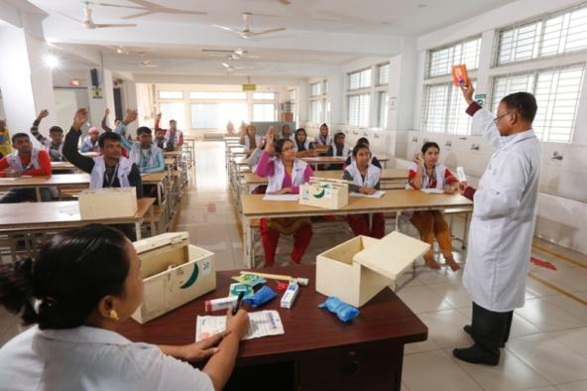
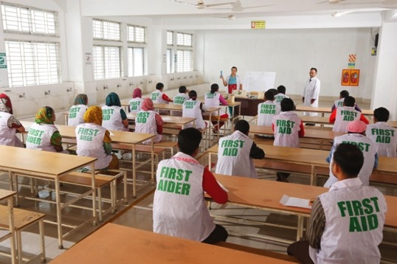
First Aid Training done every two months
Management System

Slide 36
Corporate Social Responsibility
Shovon Group of Companies adopted cleaner and improved technology and management for better environment in order to achieve its goals. Considering the buyers demand and requirements, implementing the guidelines from the world-renowned organizations for eco-friendly production.
The sustainable developments are:
Cleaner water and sanitation
Affordable and clean energy
Innovation infrastructure
Climate action and responsible consumption and production
Environmental sustainability consists of energy usage, water usage and chemical storage and handling
Using sustainable yarn like organic, bamboo and banana
Using recycled yarns
Tree plantation on production plant
Waste water treatment plant
Re use of water
Re use of waste steam
Condensate recovery boiler
Water efficient dyes and chemicals
Use of renewable energy (solar panel)
Prismatic skylight
T5 and LED light
Sustainability reporting and etc.
Resources efficiency
Energy efficiency → Reducing energy usage → Maximize alternative energy resources
Water efficiency → Reducing water usage → Maximize alternative water supply
Material efficiency → Optimizing material flow and usage → Manage inventory and procurement

Slide 37
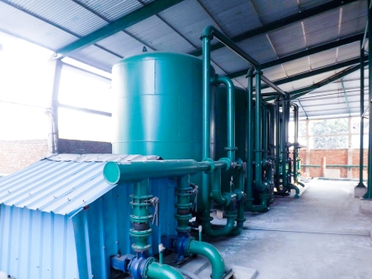
Water Softening Plant: water treated to minimize the hardness before consuming for dyeing process to reduce chemical consumption.
Corporate Social Responsibility

Slide 38
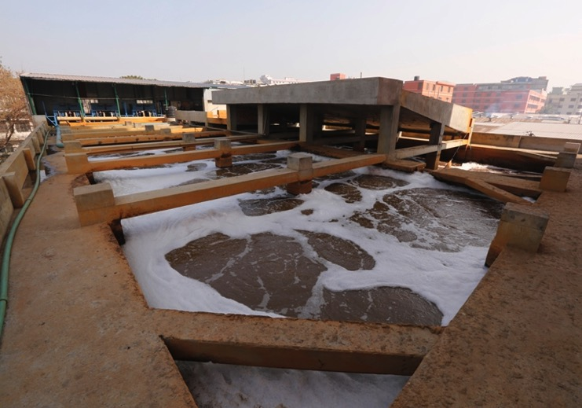
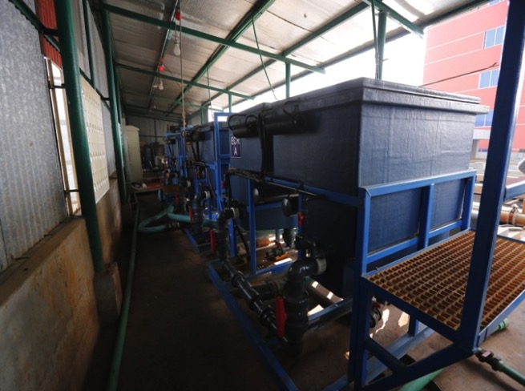
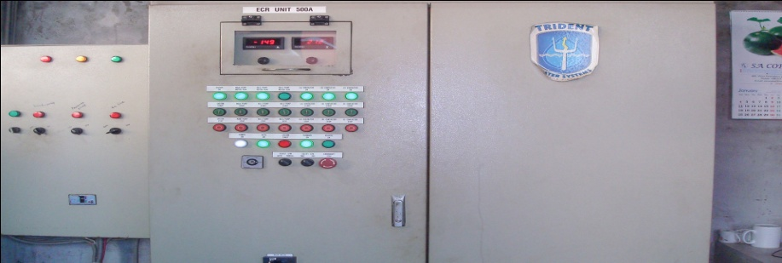
Effluent Treatment Plant: Water released form the dyeing house goes to the Effluent Treatment Plant. Highly advanced “Elector Contaminant Removal” plant removes all hazardous ingredients from the waste water. Advanced aeration system maintains Dissolved Oxygen level in water to its target parameters before discharged to sewerage.
Corporate Social Responsibility

Slide 39
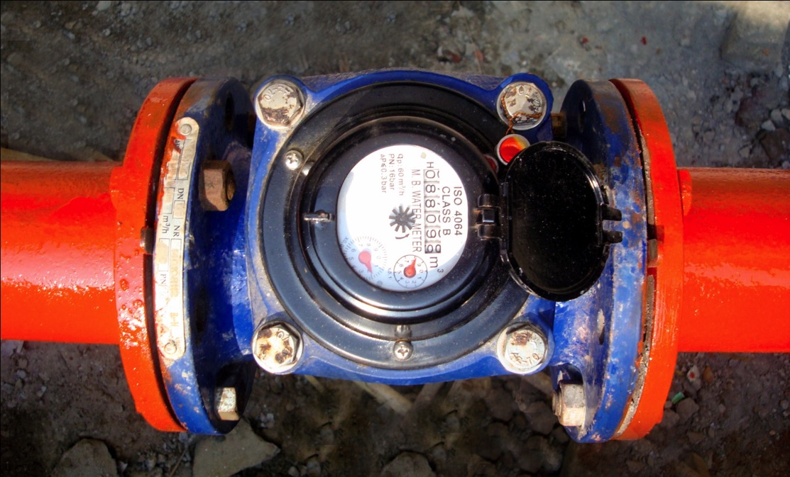
Monitoring water consumption: To minimize water consumption several flow meters are installed & the record kept periodically.
Corporate Social Responsibility

Slide 40
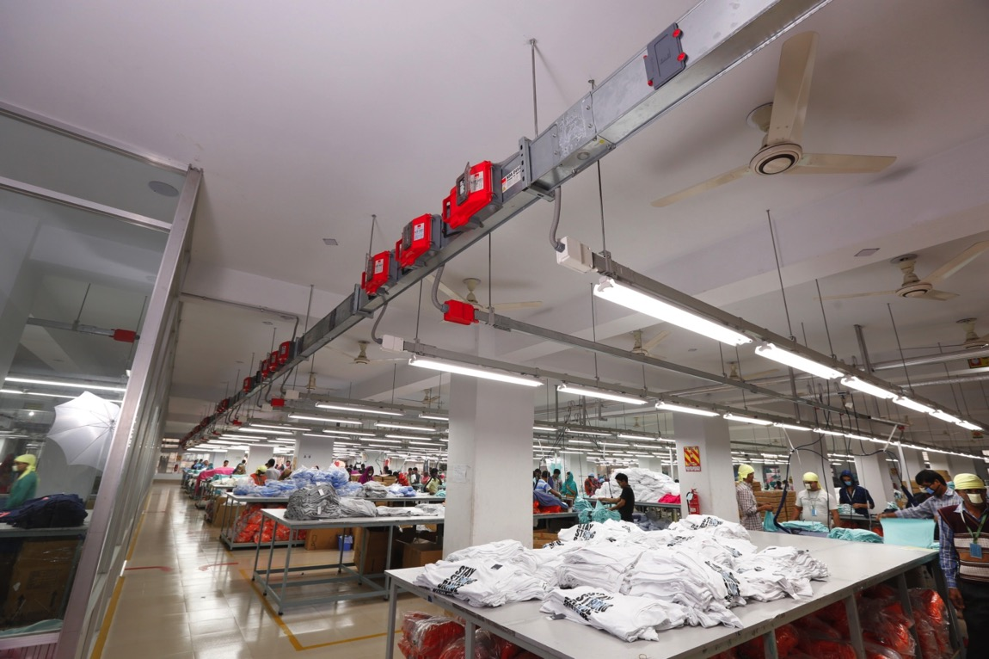
BBT system: Bus Bar Tranking system are installed to minimize voltage drop and consumes less electricity. It is also safe from electrical short circuit & fire hazard.
Corporate Social Responsibility

Slide 41
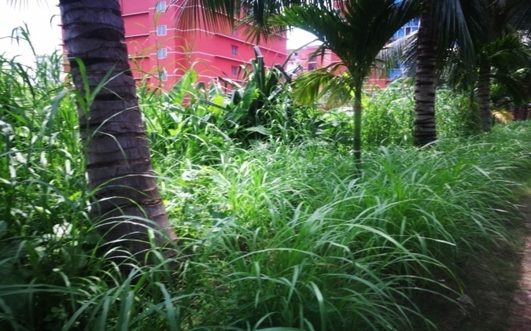
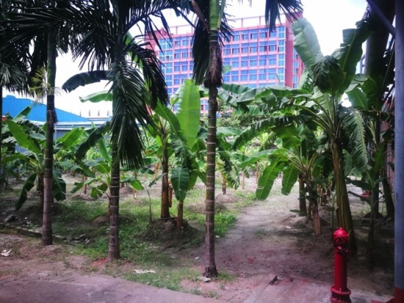
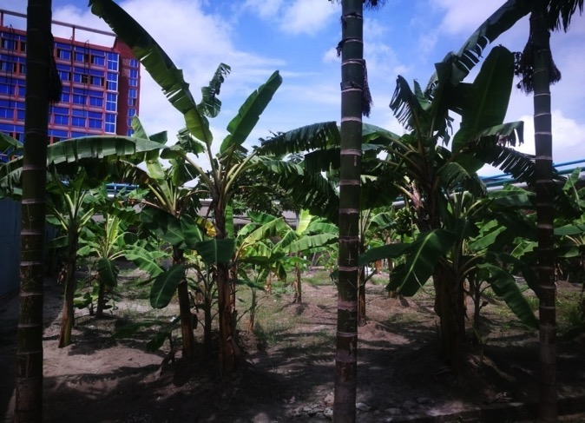
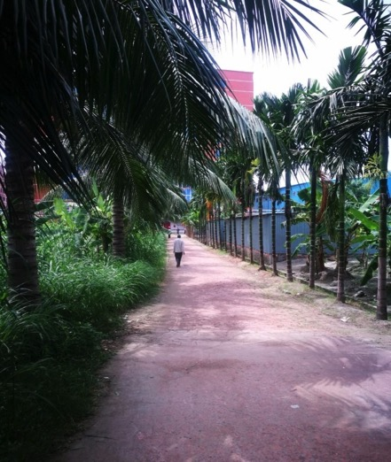
TREE PLANTATION
Corporate Social Responsibility

Slide 42
_{A D D R E S S}
West Masdair, Fatullah, Narayanganj.1400
_{Bangladesh}
Call : + 88-02-7631501/ 7631416
Fax : + 88-02-7631491 / 7631496
_{E-mail}
_{info@shovongroup-bd.com}
_{Web}
_{www.shovongroup-bd.com}
_{Bank}
_{Dutch Bangla Bank Limited}
Narayanganj Branch, Narayanganj, Bangladesh
_{Prime Bank Limited}
Narayanganj Branch, Narayanganj, Bangladesh
_{The} _{City Bank Limited}
Narayanganj Branch, Narayanganj, Bangladesh
Shovon Group of Companies Ltd.

